Slide 1
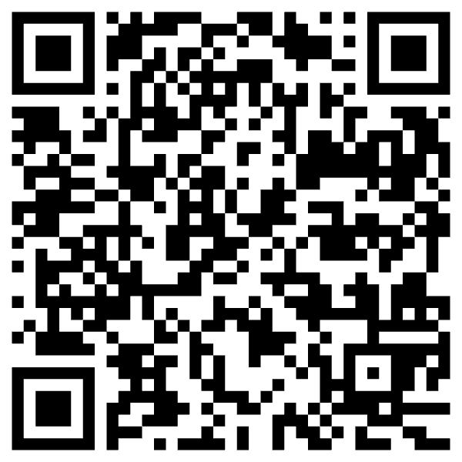
From PMI to Bots
Kenneth Church
July 2025

Slide 2

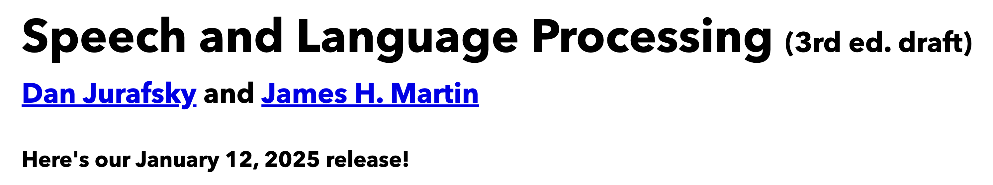
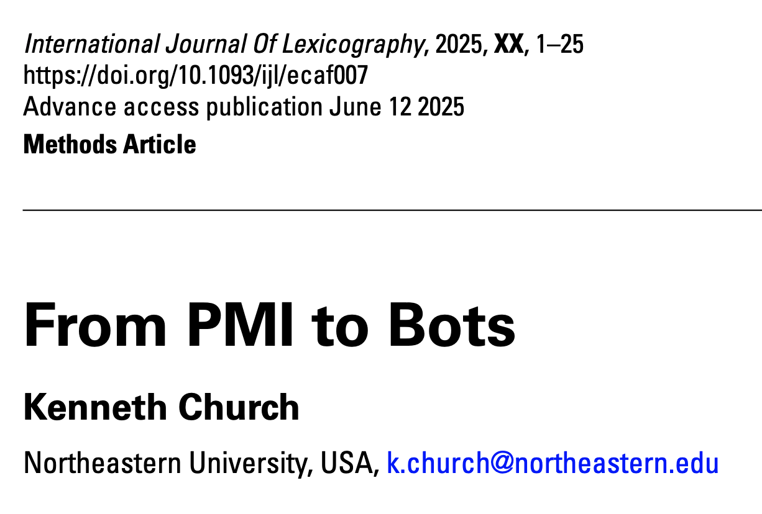
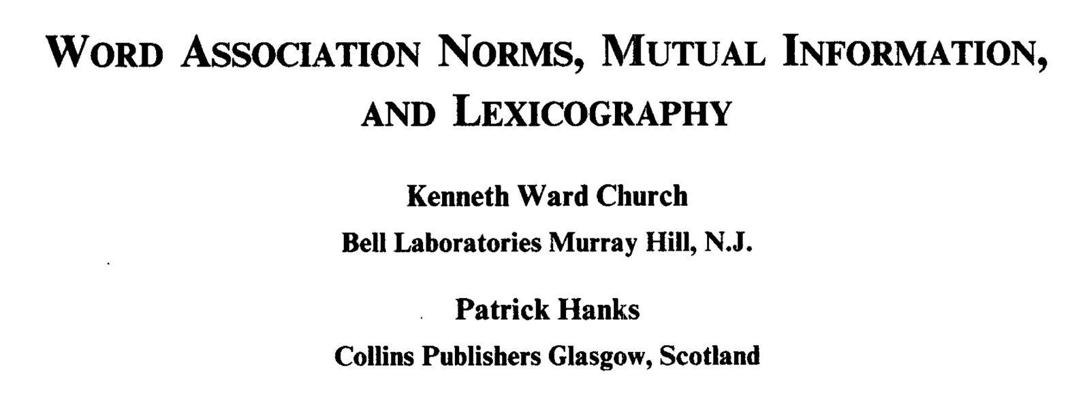
Background Reading for Today
JM: Chapter 6 (especially 6.6)
Word Association Norms, Mutual Information, and Lexicography
https://aclanthology.org/J90-1003/
From PMI to Bots (optional)

Slide 3

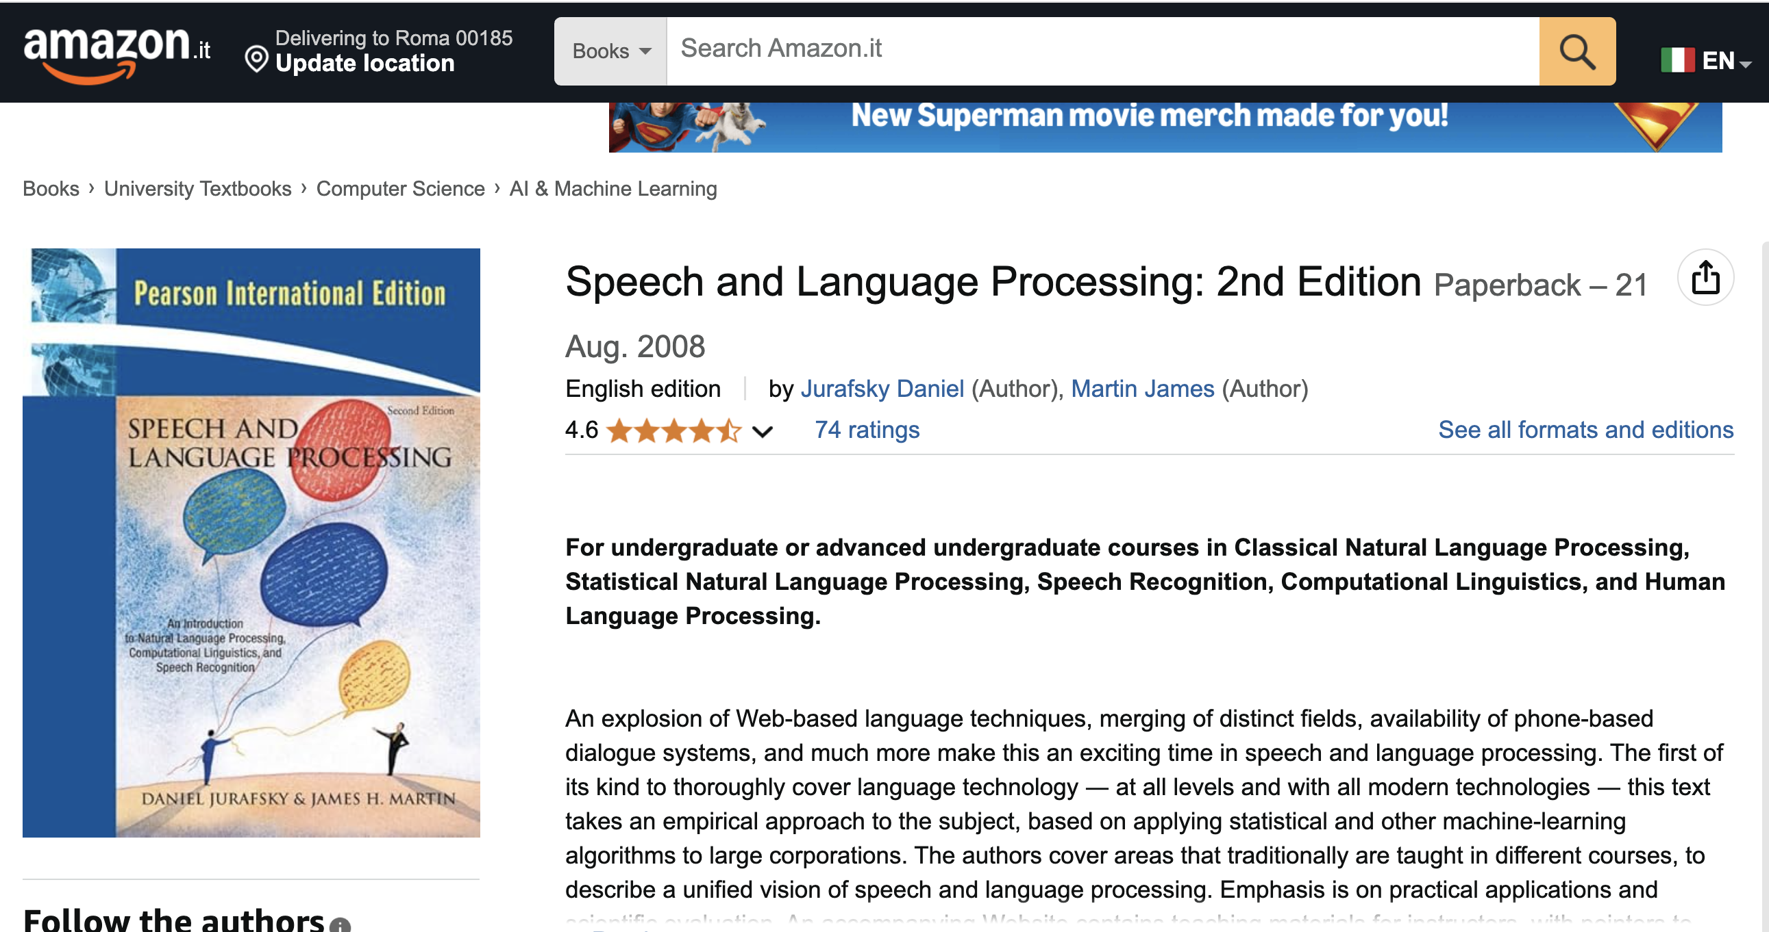
Textbook https://web.stanford.edu/~jurafsky/slp3/ JM: Chapter 6 (especially 6.6)

Slide 4
Chapter 6: Vector Semantics and Embeddings
Without Embeddings
With Embeddings
6.1: Lexical Semantics
6.2: Vector Semantics
6.3: Words and Vectors
6.4: Cosines (Similarity)
6.5: Term Weighting
6.6: Pointwise Mutual Information (PMI)
6.7: Apps of TF-IDF & PMI
6.8: Word2Vec
6.9: Visualizing Embeddings
6.10: Semantic Properties of Embeddings
6.11: Bias and Embeddings
6.12: Evaluating Vector Models
6.13: Summary

Slide 5
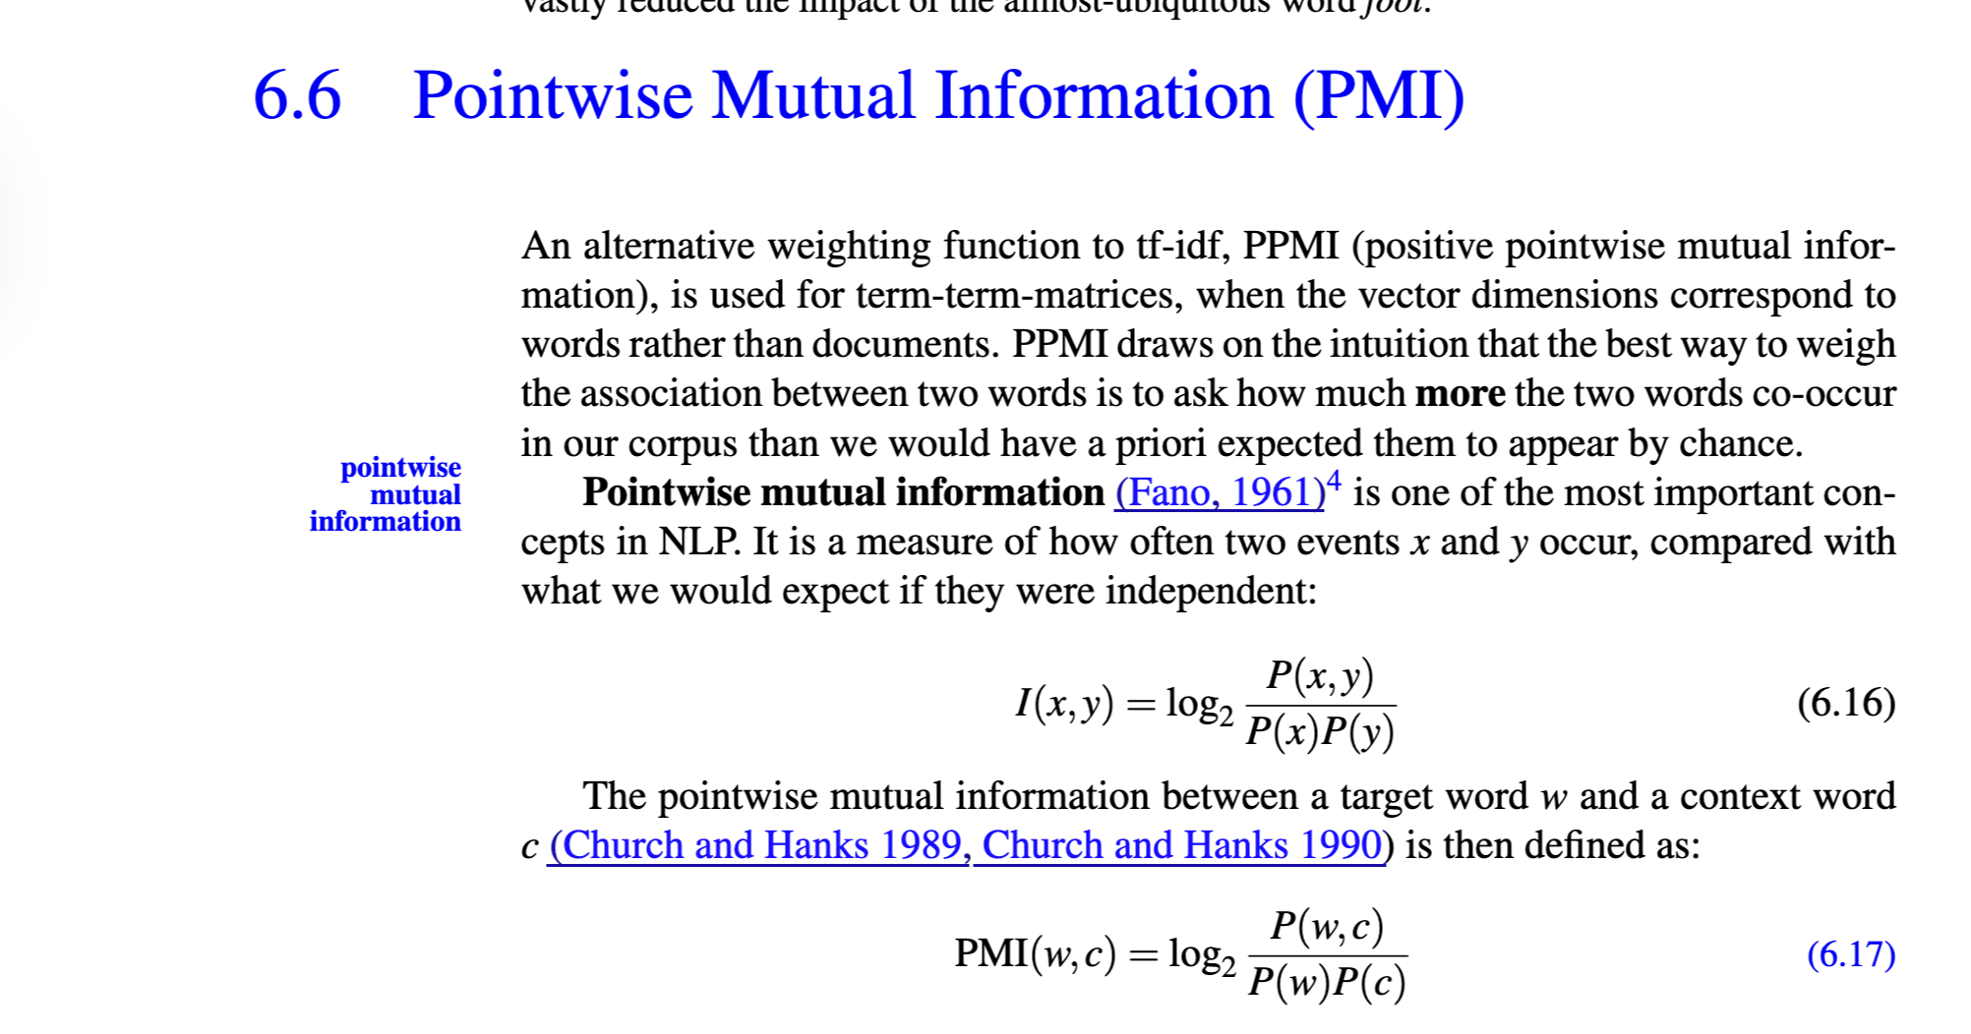
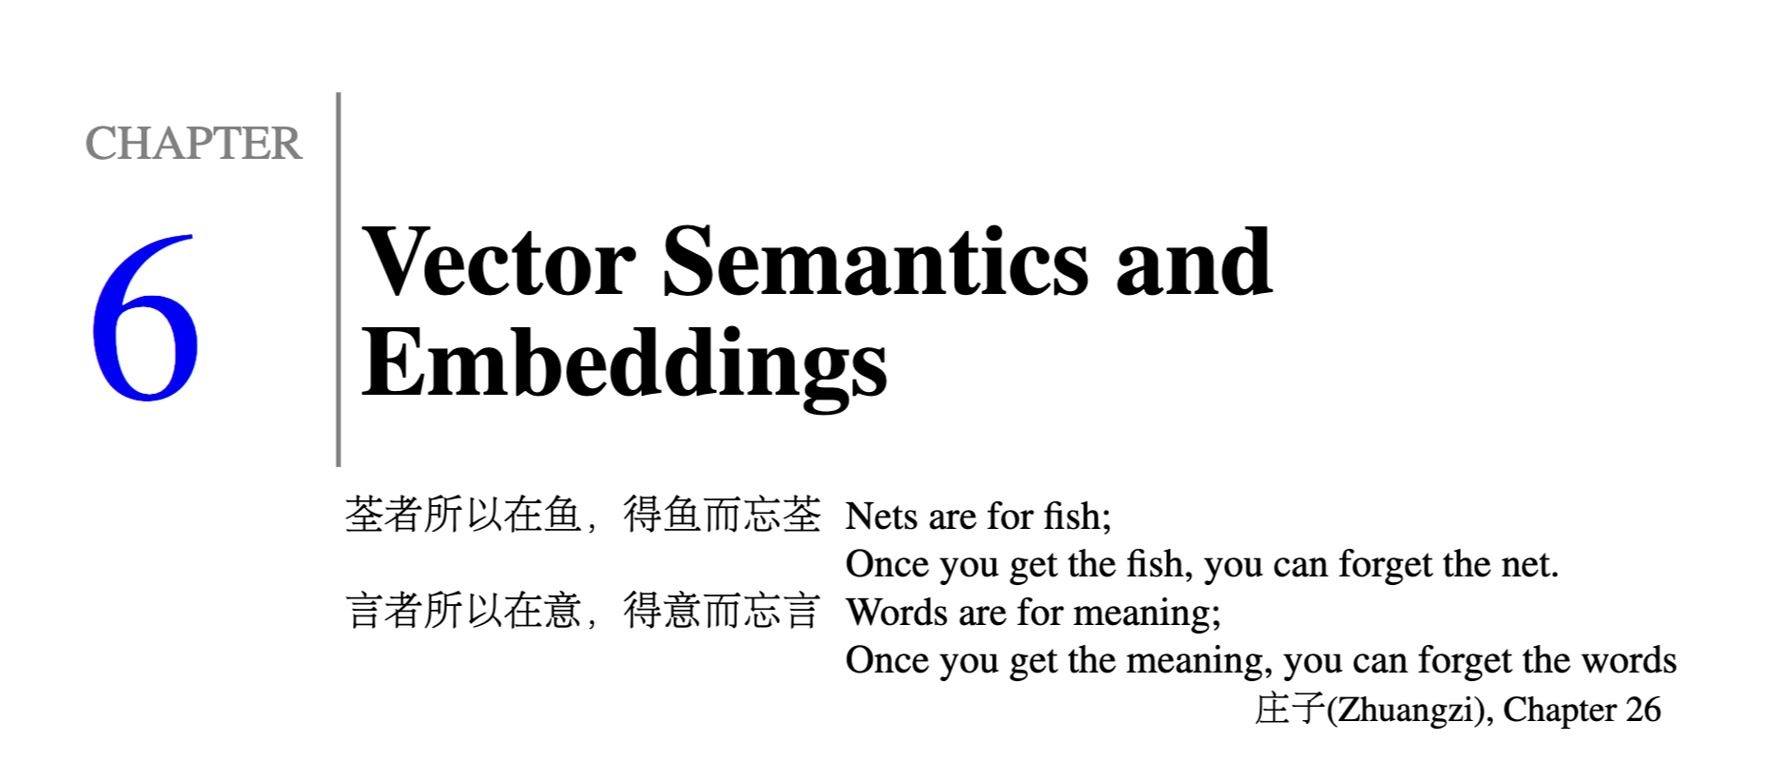

Slide 6
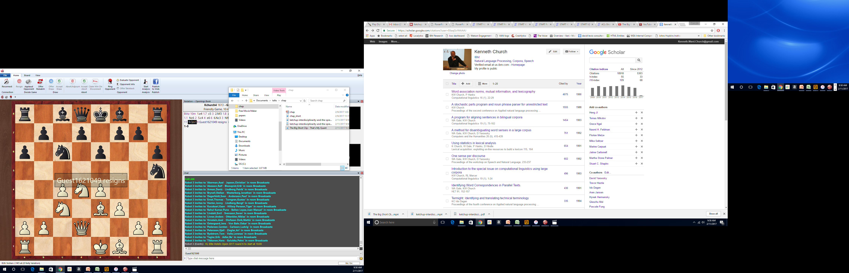
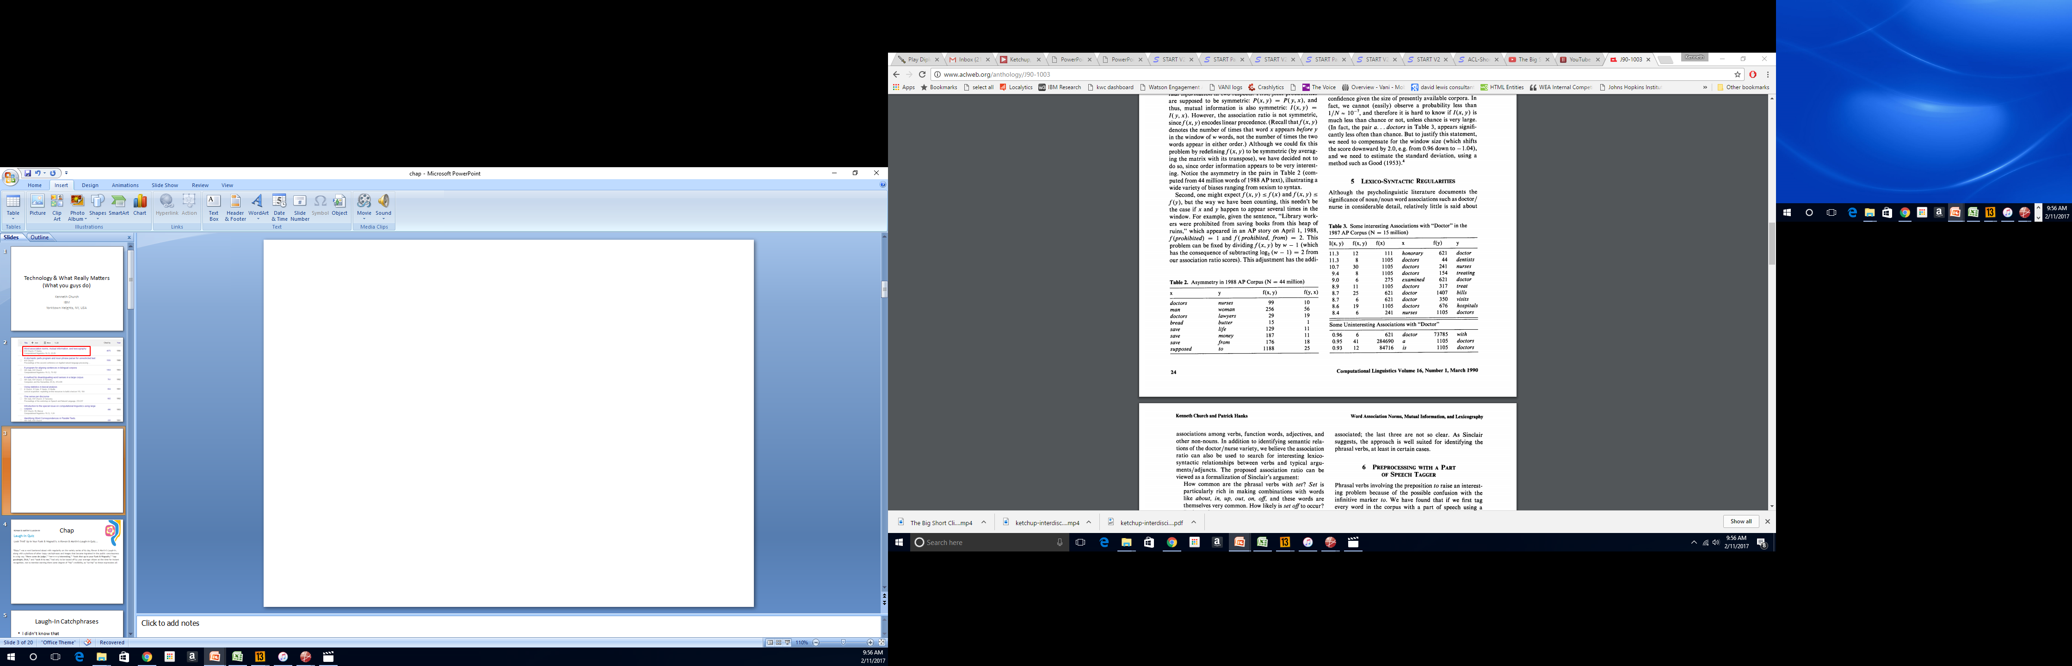
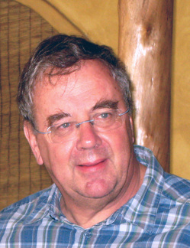

Slide 7
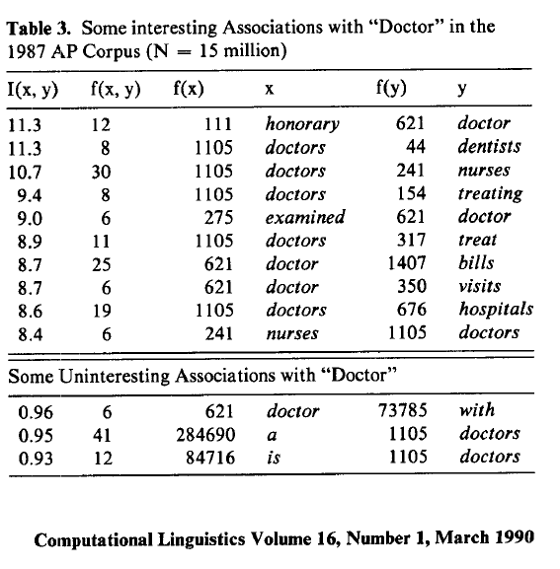
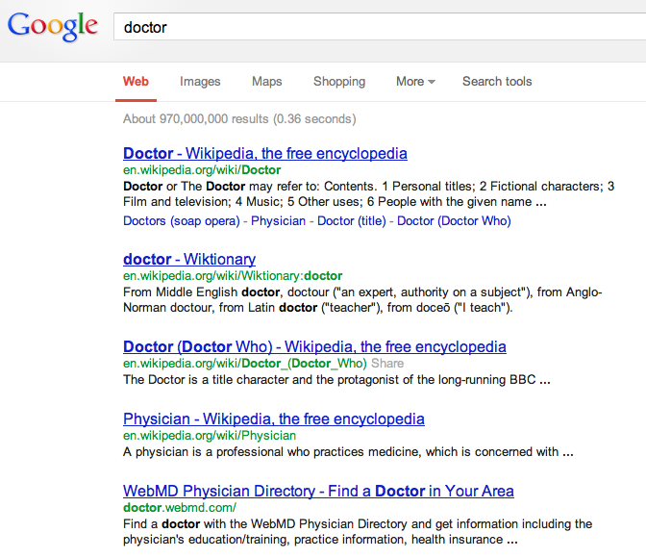
There is no data like more data
Counts are growing 1000x per decade
(same as disks)
Counts are growing 1000x per decade
(same as disks)
Rising Tide of Data Lifts All Boats

Slide 8
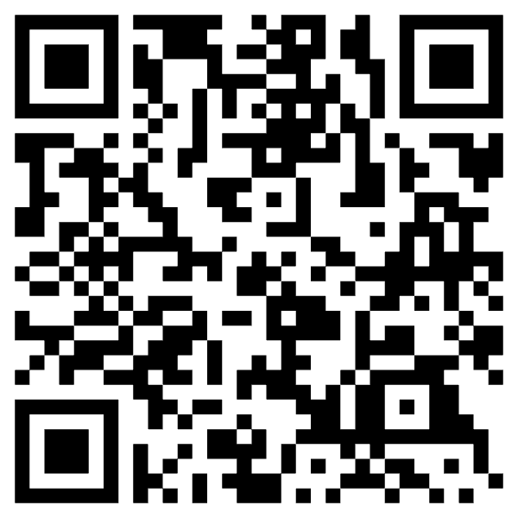
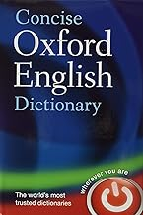
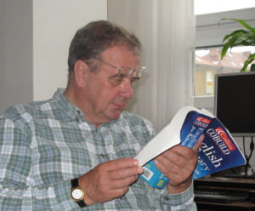
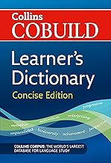
Special Issue of International Journal of Lexicography in Memory of Patrick Hanks

Slide 9
Bigger Picture: A personal perspective not found in textbooks
Connecting the Dots
CogSci: Interdisciplinary
Past, Present and Future
Where have we been and where are we going?
Word Associations
Psychology
Psycholinguistics
Humanities
Linguistics
Syntax, Semantics, Phonology & Phonetics
Lexicography: Corpus-based methods
Translation
Education:
Testing (Vocabulary Size)
Math
Statistics & Linear Algebra
Engineering
Information Theory, Artificial Intelligence (AI), Machine Learning (ML), Computational Linguistics (CL), Machine Translation (MT), Information Retrieval (IR), Speech & Vision
Past: PMI
Present
Future: Bots
Mutual Information
Connect Three Dots

Slide 10
From PMI to Bots Connecting the dots between the past and the future
PMI → Word2Vec → Bots
PMI (Past): Pointwise Mutual Information
Original Motivation for PMI:
Help Lexicographers to find interesting “collocations”
Need to explain “collocations”
and connect the dots between collocations and lexical semantics
Word2Vec: factored representation of PMI
Bots (Future): Word2Vec → Doc2Vec
Embeddings: Represent “everything” as vectors
Everything:
Words (in all languages)
Documents (in all languages)
Multi-modal: Text, Speech, Pictures, Videos
Answer all questions by table lookup (cosine similarity of vectors)

Slide 11

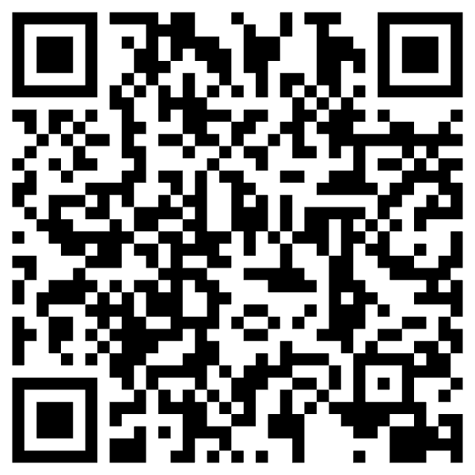
https://www.chronicle.com/article/im-a-student-you-have-no-idea-how-much-were-using-chatgpt

Slide 12
Cheating: Do’s and Don’ts
Do’s
Don’ts (Cheating)
Bots are more fluent
than trustworthy
Use bots to improve fluency
Modern version of a thesaurus
Assume responsibility
for what you say
Human-in-the-loop
Collaboration
Machines are better at fluency
Humans are more trustworthy
Traffic in misinformation
Use bots to get a good grade without mastering the material
You are only cheating yourself
End-to-End Systems
Self-organizing
Turn-key
Fire experts:
linguists, historians, programmers,
yourself

Slide 13
Computational Linguistics: An Interdisciplinary Combination of Engineering and Humanities
Engineering
Humanities & CogSci
Information Theory (Shannon)
Large Language Models (LLMs)
Embeddings
Bots: ChatGPT, DeepSeek
Linguistics
Psycholinguistics
Lexicography
Education
Testing: Vocabulary Size
Language Learning
Translation
Recent Excitement in AI

Slide 14
Narrative/Hype: Bots are completely “new” But there is much to learn from the Past
Past
Empiricism
Find data (corpora) to settle open questions
1950s: Empiricism
(Shannon, Skinner, Firth, Harris)
1970s: Rationalism
(Chomsky, Minsky)
1990s: Revival of empiricism
(IBM, AT&T Bell Labs)
2010s: Extreme empiricism
(LLMs, ChatGPT & DeepSeek)
Distributional Hypothesis
Zellig Harris (Chomsky’s Advisor)
You shall know a word by the company it keeps
– Firth (1957)
Every time I fire a linguist,
the performance of the speech recognizer goes up
– Jelinek (2004)
There is no data like more data
– Mercer (1988)
Collocations

Slide 15
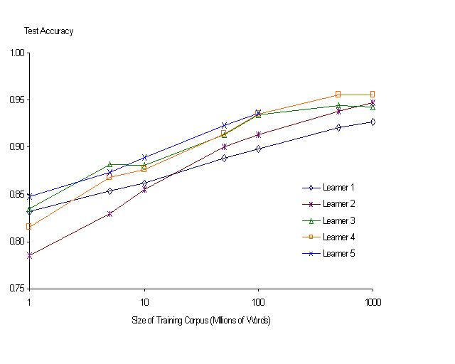
“It never pays to think until you’ve run out of data” – Eric Brill
Banko & Brill: Mitigating the Paucity-of-Data Problem (HLT 2001)
Moore’s Law Constant:
Data Collection Rates → Improvement Rates
No consistently
best learner
There is no data like more data
Quoted out of context
Fire everybody and
spend the money on data

Slide 16
Rationalism v. Empiricism (Grandparents and Grandchildren)
1950s: Empiricism
(Shannon, Skinner, Firth, Harris)
1970s: Rationalism
(Chomsky, Minsky)
1990s: Revival of empiricism
(IBM, AT&T Bell Labs)
2010s: Extreme empiricism
(LLMs, ChatGPT & DeepSeek)
Distributional Hypothesis
Zellig Harris (Chomsky’s Advisor)
You shall know a word by the company it keeps
– Firth (1957)
Every time I fire a linguist, the performance of the speech recognizer goes up
– Jelinek (2004)
There is no data like more data
– Mercer (1988)

Slide 17
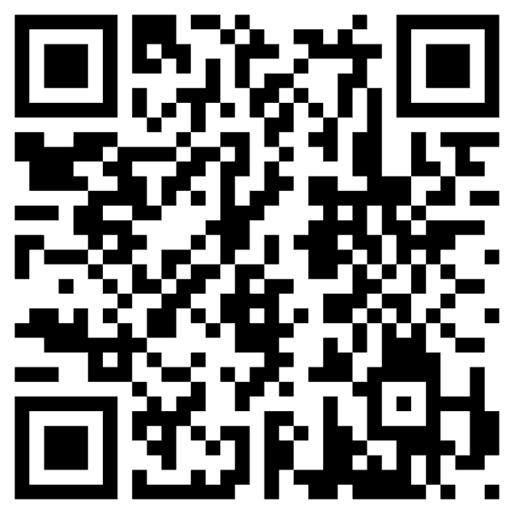
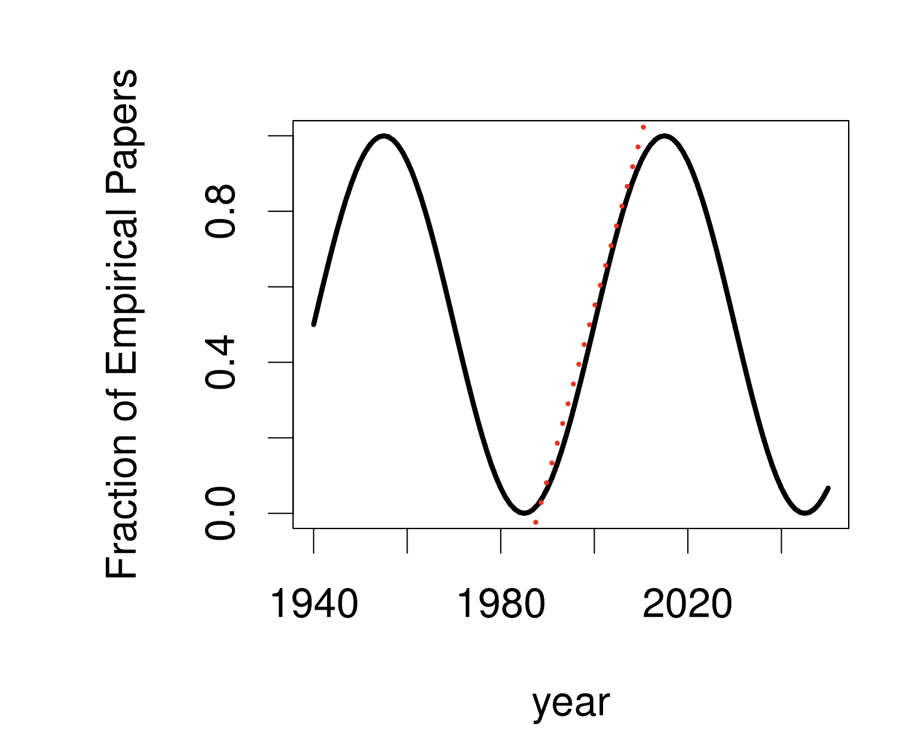
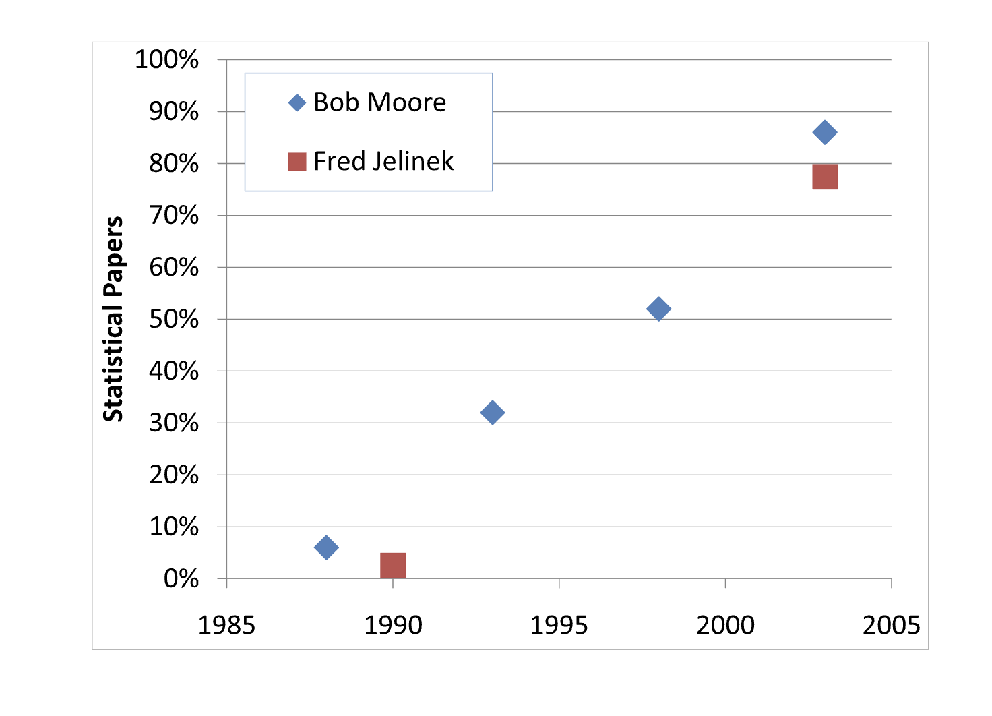
A Pendulum Swung Too Far Church, K. 2011. A Pendulum Swung Too Far. Linguistic Issues in Language Technology
1950s: Empiricism
(Shannon, Skinner, Firth, Harris)
1970s: Rationalism
(Chomsky, Minsky)
1990s: Revival of empiricism
(IBM, AT&T Bell Labs)
2010s: Revival of rationalism (?)
Extreme empiricism
(LLMs, ChatGPT & DeepSeek)
Students rebel every twenty years
Grandparents & Grandchildren

Slide 18
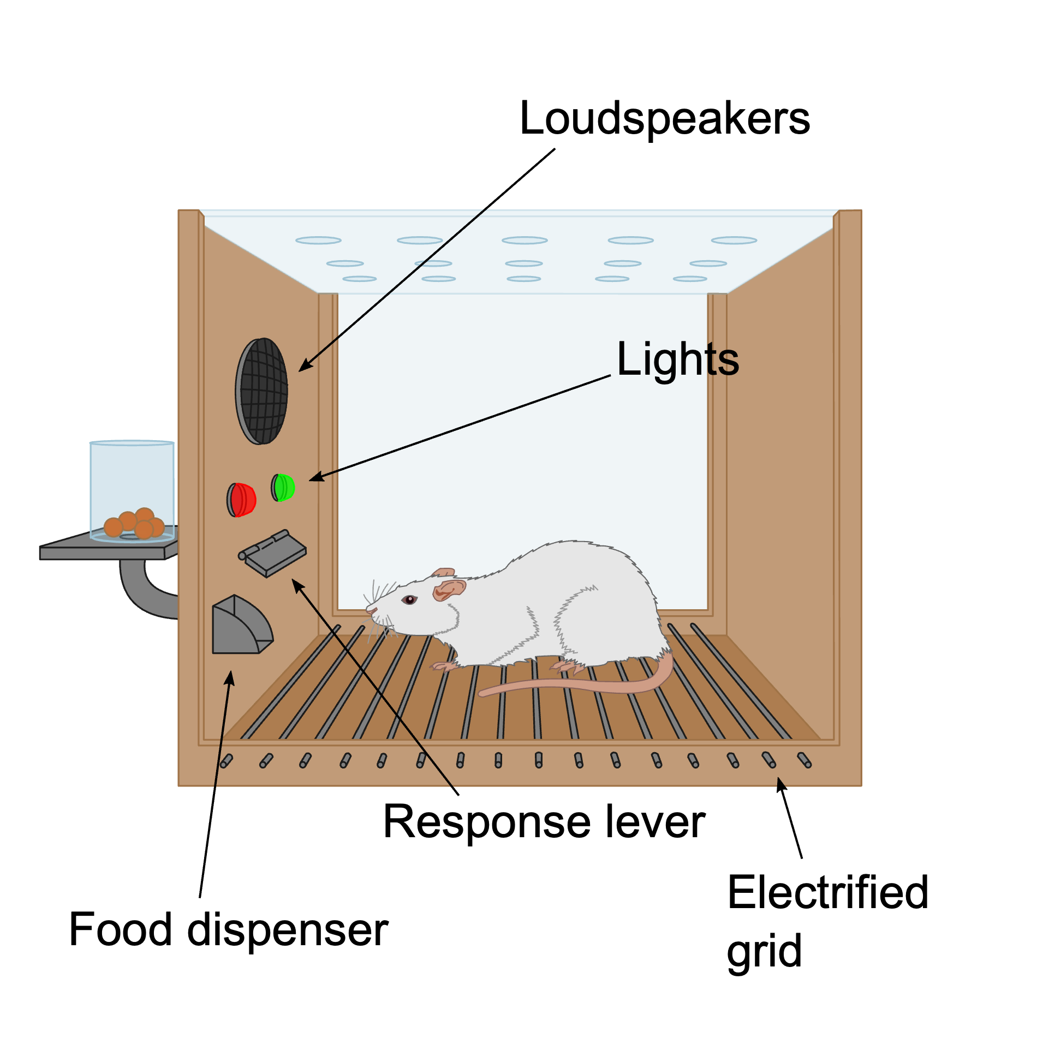
Cognitive Science & Harvard in 1950s
CogSci
George Miller (CogSci)
Noam Chomsky (Linguistics)
Marvin Minsky (AI)
CogSci: Reaction to
Information Theory
Claude Shannon
Behaviorism
BF Skinner
My father (Russell Church)
Q: Have I been in a Skinner box?
A: Yes
Empiricism
Zipf
By Original: AndreasJS Vector: Pixelsquid - This file was derived from: Skinner box scheme 01.png: by AndreasJS, CC BY-SA 3.0, https://commons.wikimedia.org/w/index.php?curid=99322433

Slide 19
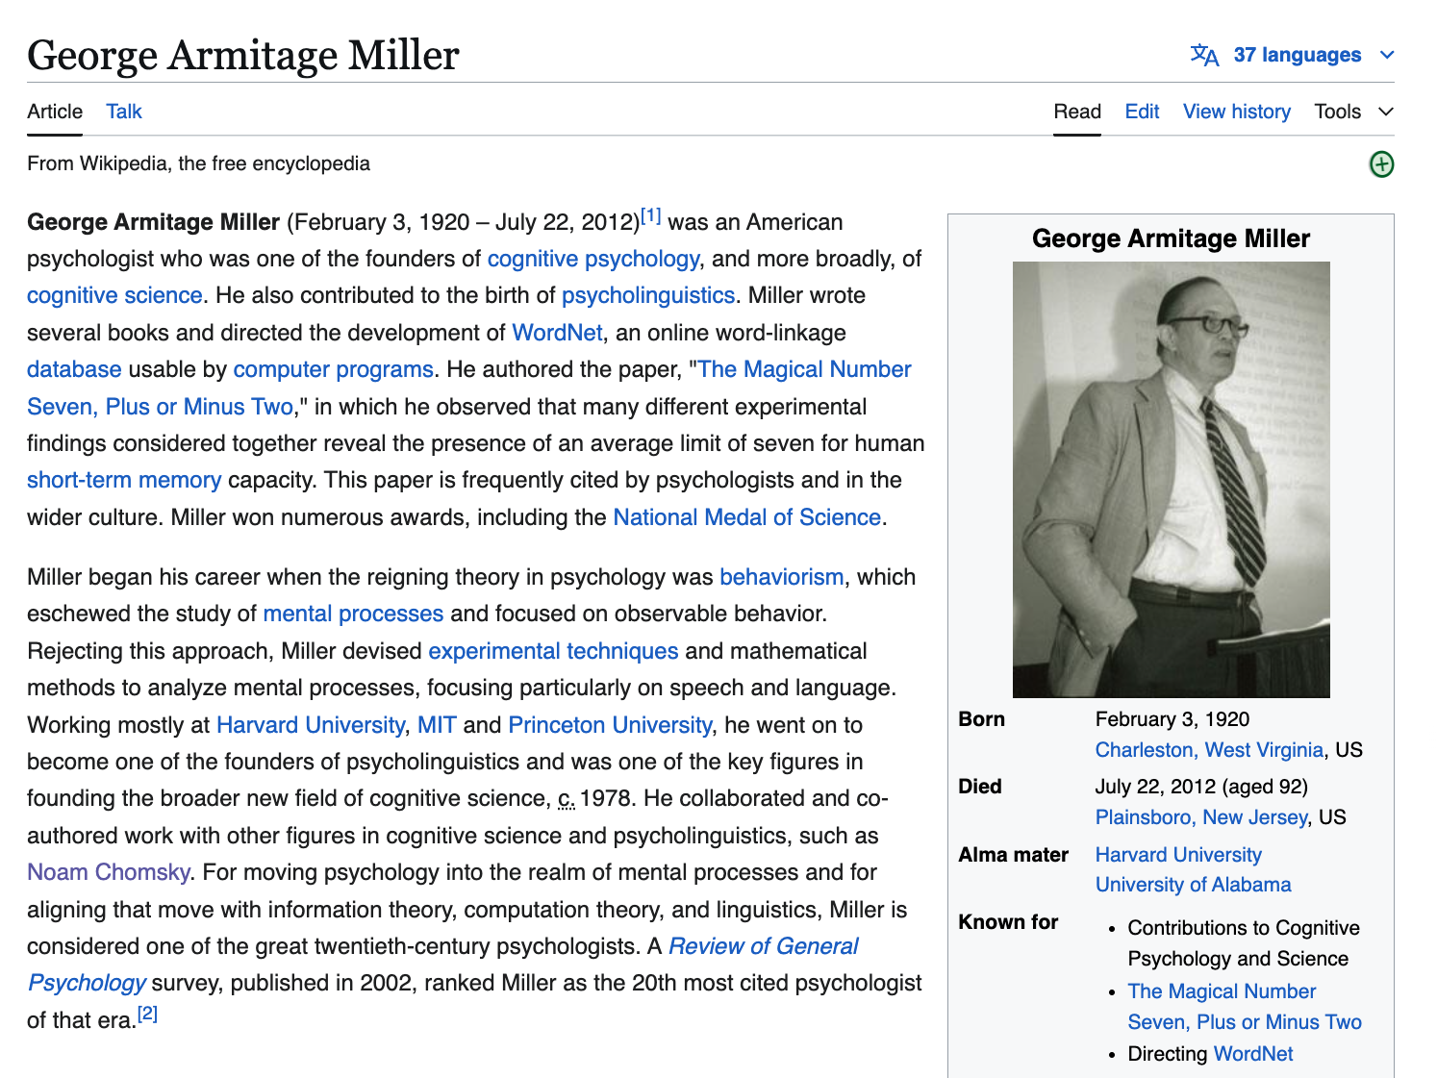
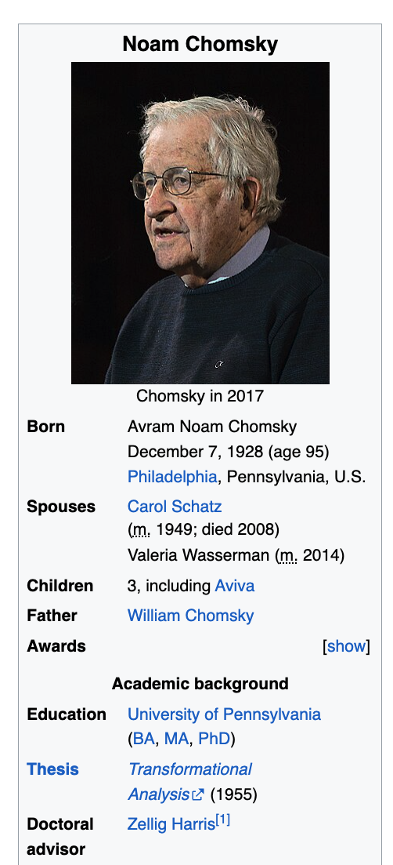

Slide 20
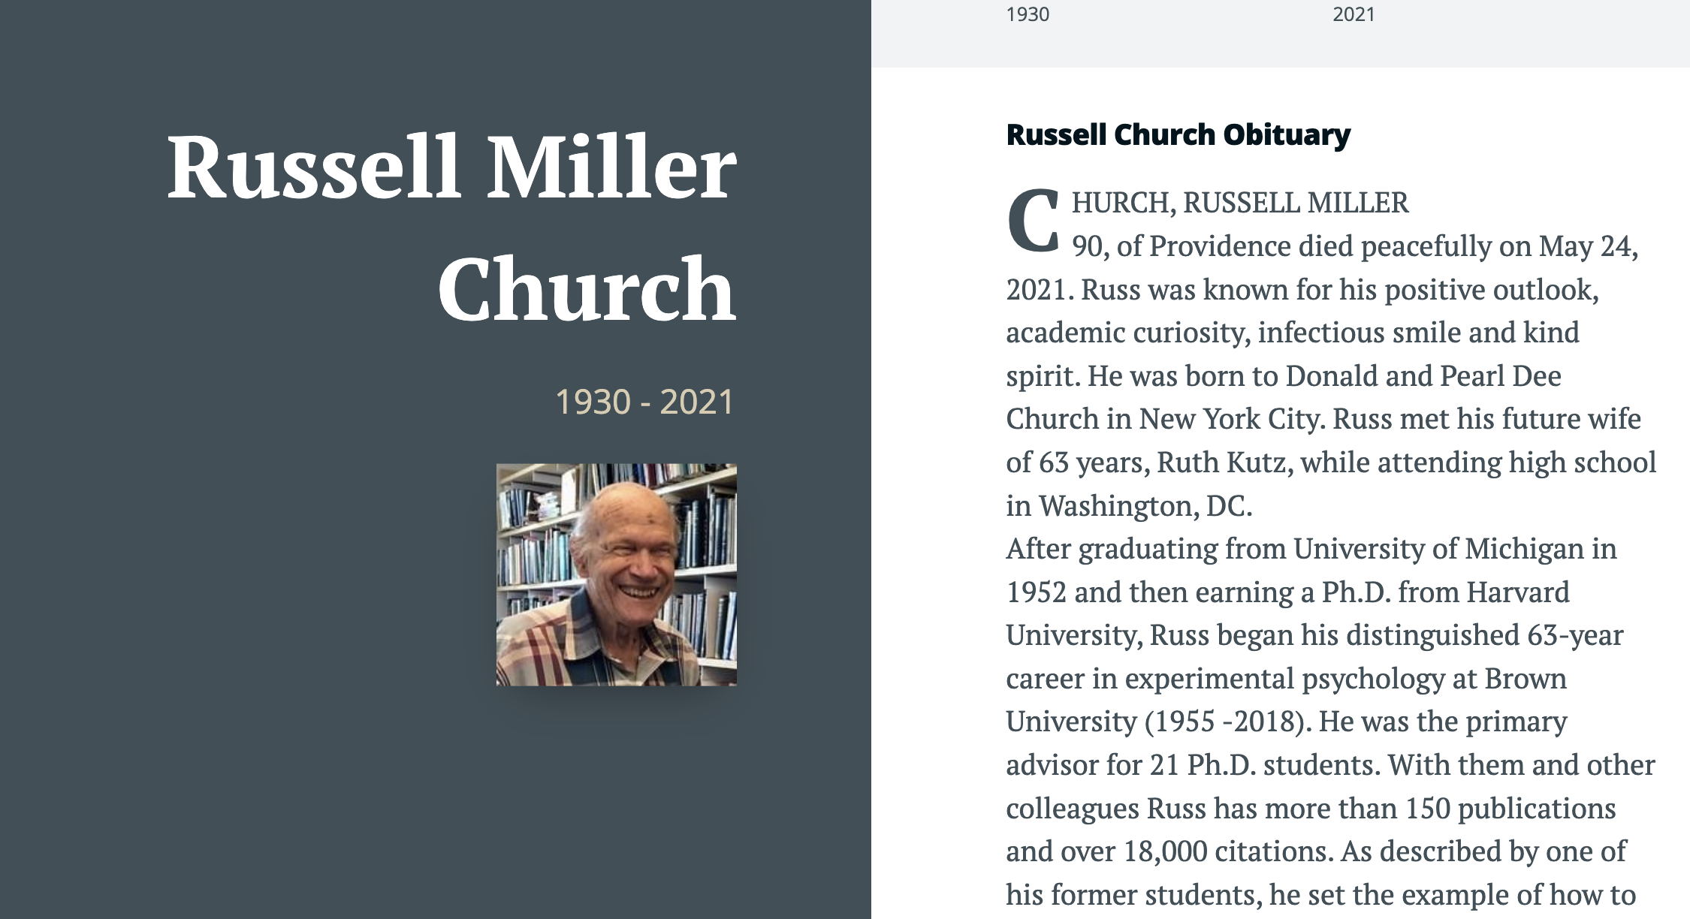

Slide 21
Brown Corpus: Influential over many fields
Brown Corpus: widely cited over many fields:
Information Retrieval
Baeza-Yates and Ribeiro-Neto (1999)
Lexicography
Miller (1995)
Sociolinguistics
Biber (1991)
Psychology
MacWhinney (2000)
Computational Linguistics
Marcus et al (1993)
Jurafsky and Martin (2000)
Church and Hanks (1990)
Resnik (1995)
6/27/2014
Fillmore Workshop
21

Slide 22
Brown Corpus is a Balanced Corpus (Unlike many recent catch-as-catch-can corpora)
A sample of 1M words
Contemporary (1960s)
American English
Balanced over 15 genres (A-R)
500 documents
2000 words each
15 Genres: A-R (500 documents)
Press: A (44) reportage, B (27) editorial, C (17) reviews
Religion: D (17)
Skills and hobbies: E (36)
Popular lore: F (48)
Belle-letters: G (75)
Misc: H (30): gov docs, foundation reports, industry reports, college catalog
Learned: J (80): science, medicine, math, social science, humanities, engineering
Fiction: K (29) general, L (24) mystery, M (6) science fiction, N (29) Westerns, P (29) romance, R (9) humor
There is no data like more data
6/27/2014
Fillmore Workshop
22

Slide 23
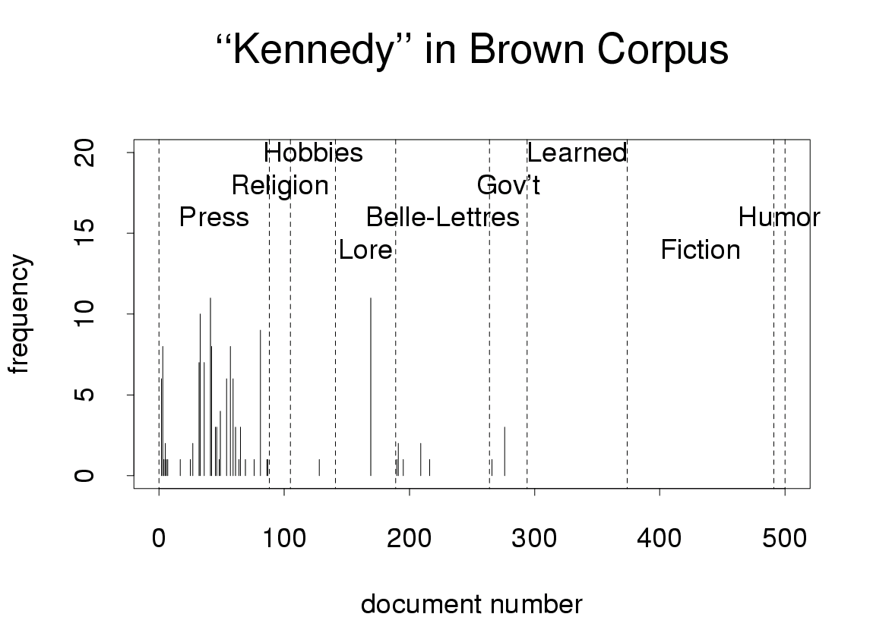

Slide 24
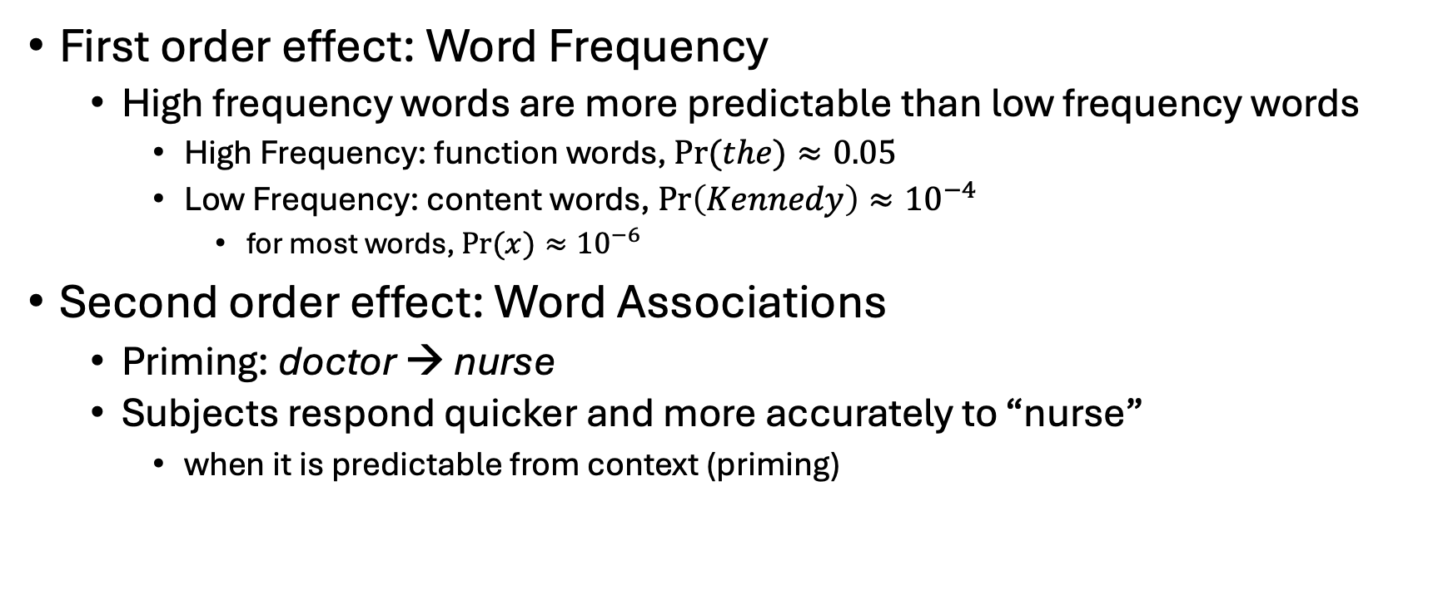
More predictable contexts → Faster reaction times (RT) (Predictability can be estimated from corpora)
First order effect: Word Frequency
High frequency words are more predictable than low frequency words
High Frequency: function words, $Pr⁡(the)≈0.05$
Low Frequency: content words, $\operatorname{Pr}\left(Kennedy\right)≈{10}^{−4}$
for most words, $Pr⁡(x)≈{10}^{−6}$
Second order effect: Word Associations
Priming: doctor → nurse
Subjects respond quicker and more accurately to “nurse”
when it is predictable from context (priming)

Slide 25
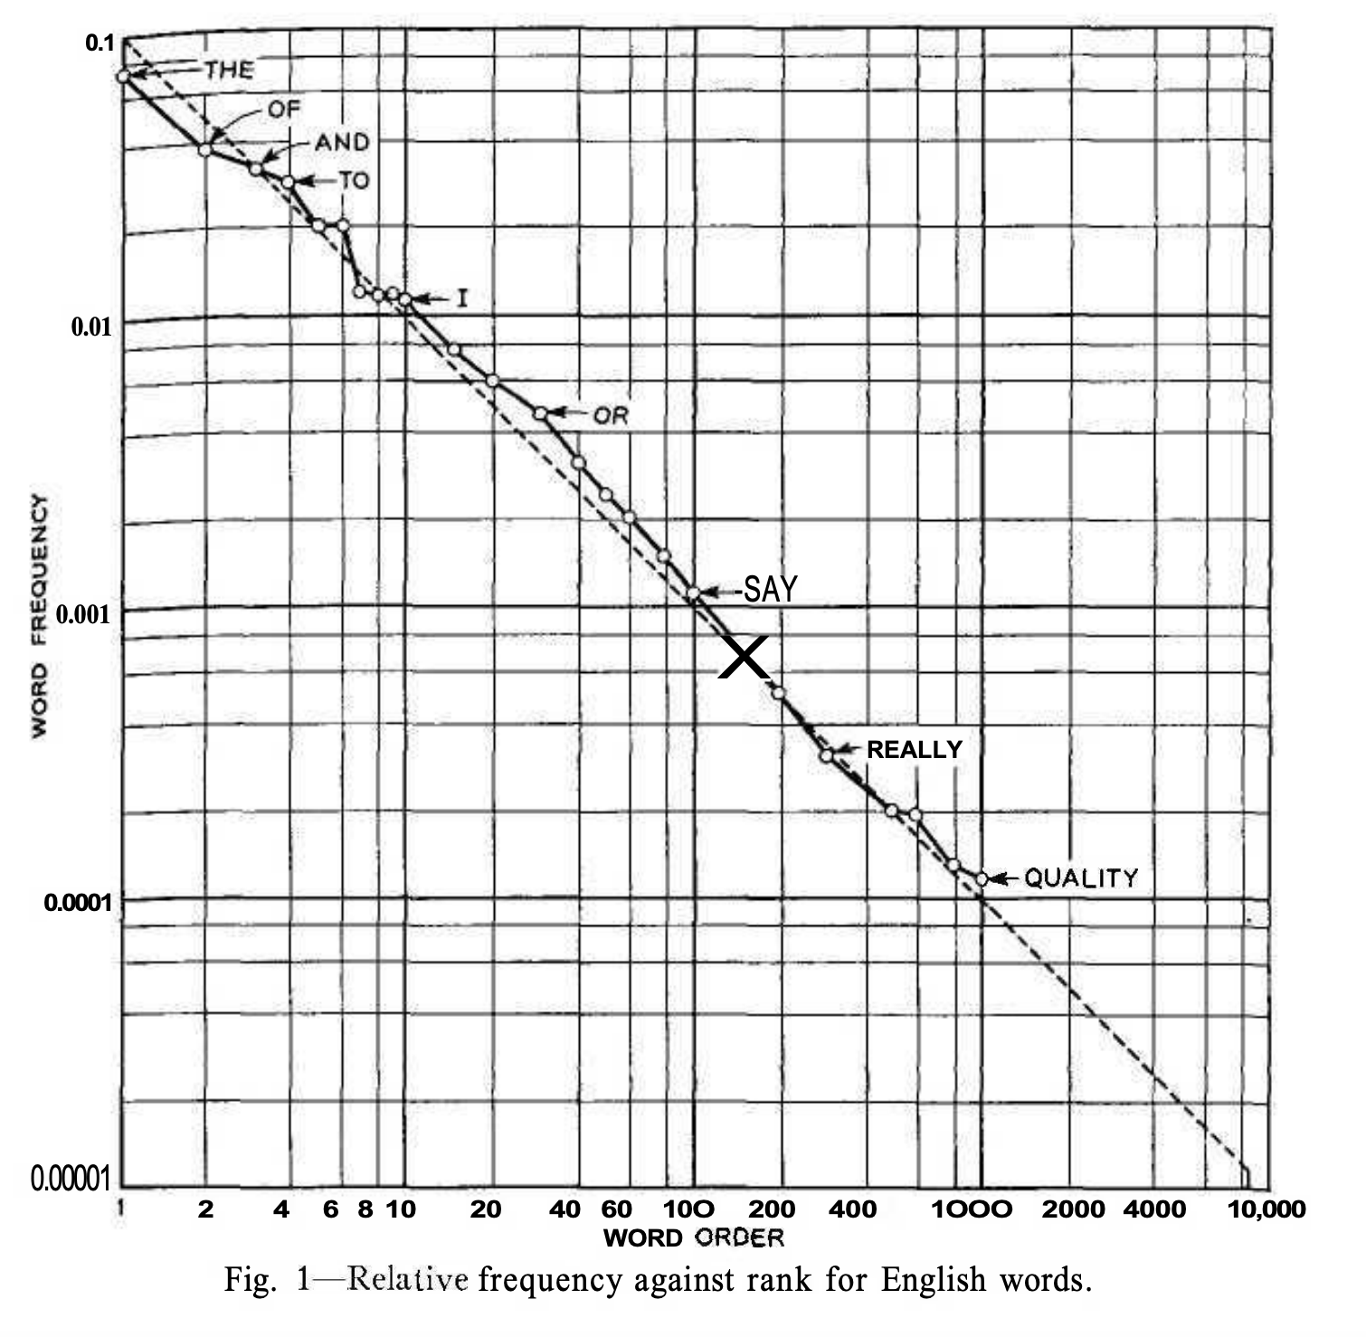

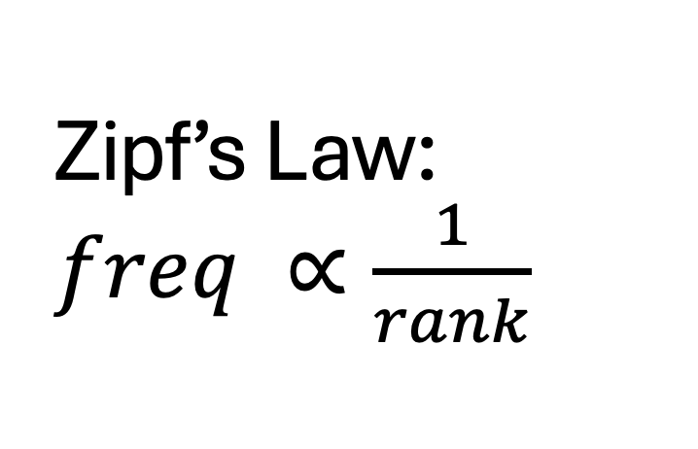

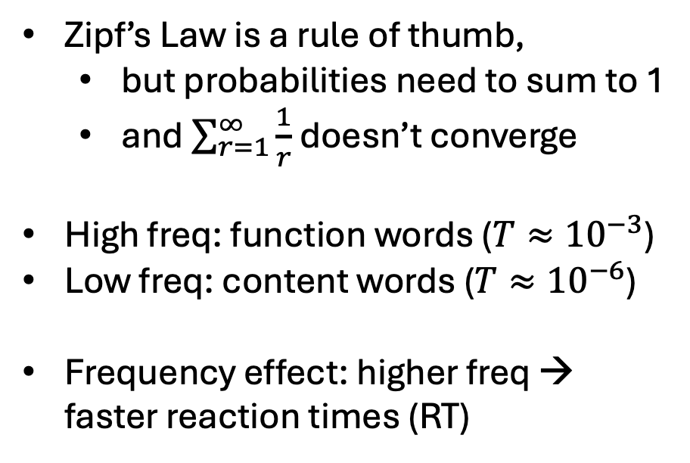

Zipf’s Law: $freq ∝\frac{1}{rank}$
Function Words
$$\operatorname{Pr}\left(x\right)>T$$
$$T$$
Zipf’s Law is a rule of thumb,
but probabilities need to sum to 1
and $\sum_{r=1}^{∞}{\frac{1}{r}}$ doesn’t converge
High freq: function words ($T≈{10}^{−3}$)
Low freq: content words ($T≈{10}^{−6}$)
Frequency effect: higher freq → faster reaction times (RT)
Content Words
$$\operatorname{Pr}\left(x\right)<T$$
Figure from Shannon’s paper on entropy of English

Slide 26
Predictable contexts
Easier for people
Subjects respond quicker and more accurately
when contexts are predictable
Also, easier for machines
Web search
Bots
Information Retrieval
Speech recognition
Vision
Predictability varies over time and space

Slide 27
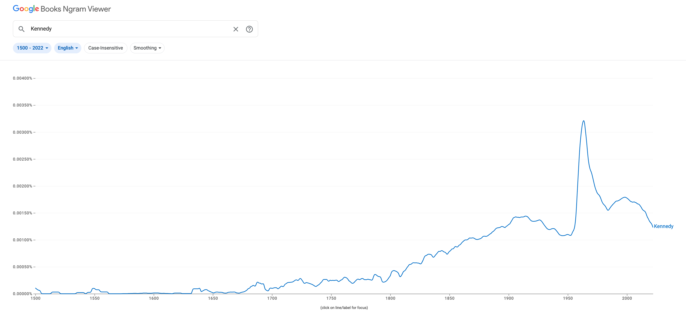
Google Ngrams for “Kennedy” Books published since 1500
Brown Corpus
WW II
Frequency depends on time

Slide 28
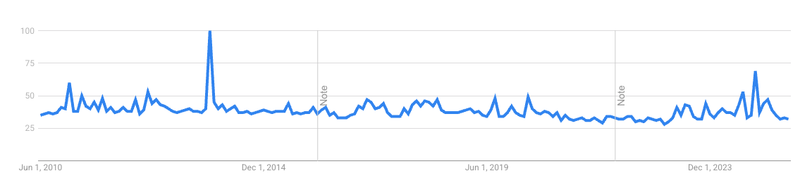
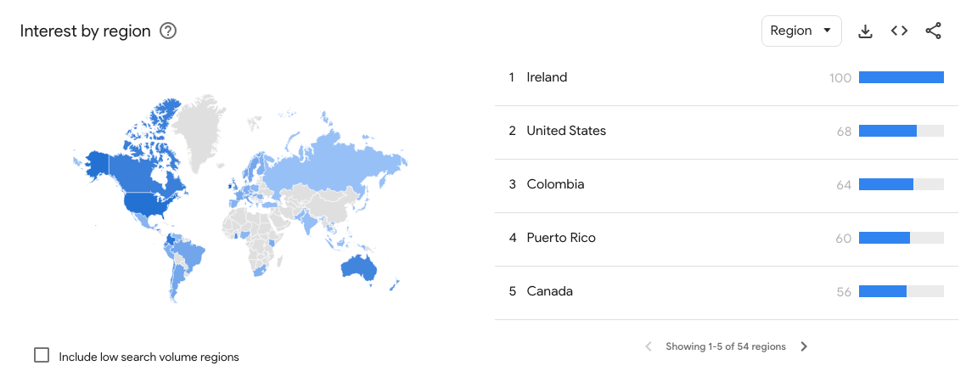
Google Trends for “Kennedy”: Queries over decades
Frequency depends on region
Region

Slide 29
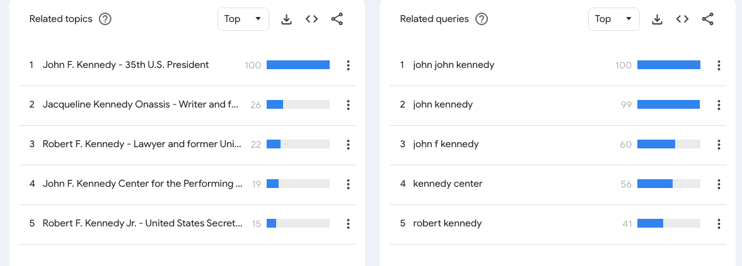
Google Trends for “Kennedy”: Queries over decades
Topics
Queries

Slide 30
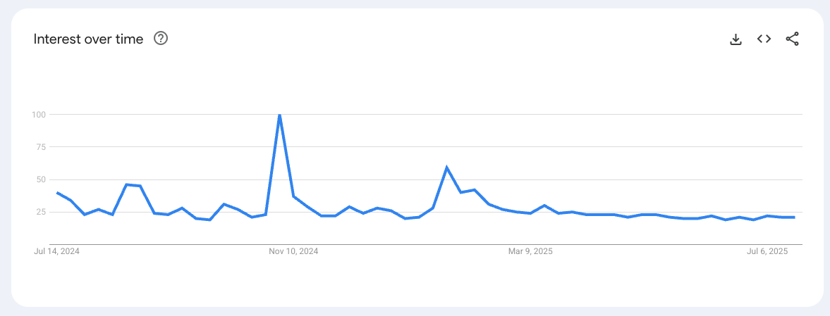
Google Trends for “Kennedy”: Queries over 12 months (7/24-7/25)
Election

Slide 31
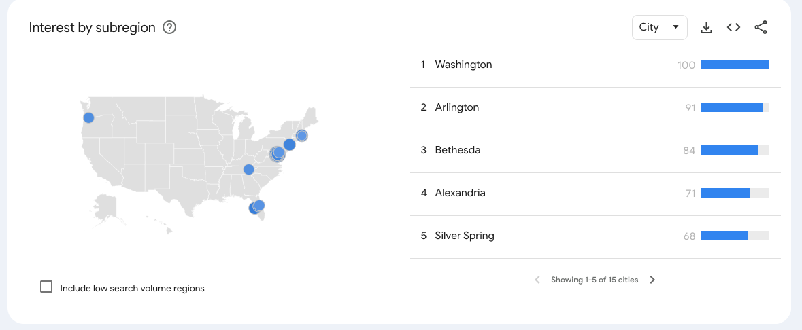
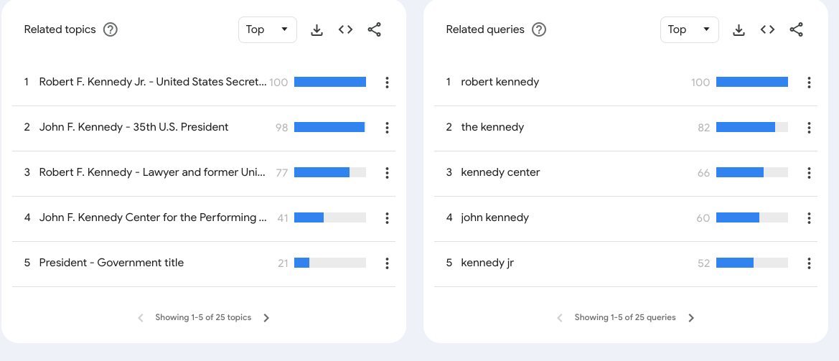
Google Trends for “Kennedy”: Queries over 12 months (7/24-7/25)

Slide 32
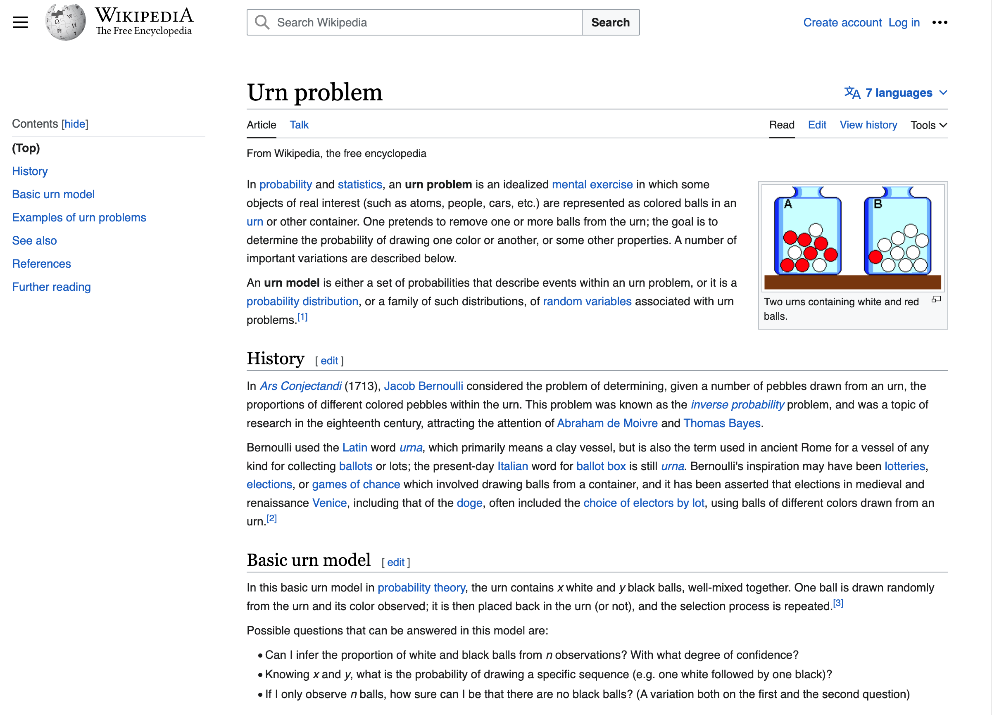
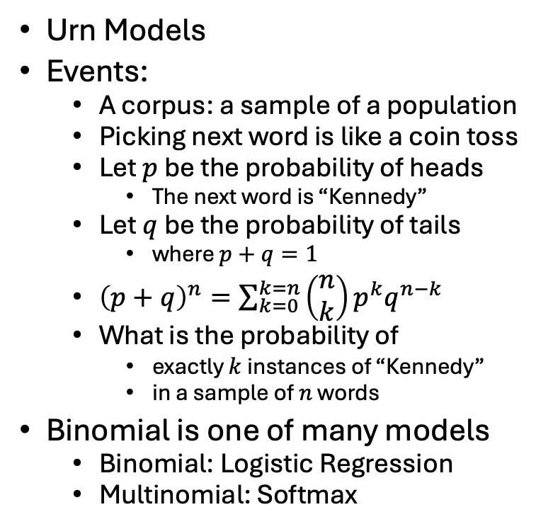
Probability Theory
Urn Models
Events:
A corpus: a sample of a population
Picking next word is like a coin toss
Let $p$ be the probability of heads
The next word is “Kennedy”
Let $q$ be the probability of tails
where $p+q=1$
${\left(p+q\right)}^{n}=\sum_{k=0}^{k=n}{\left(\begin{matrix}n \\ k\end{matrix}\right)}p^{k}q^{n−k}$
What is the probability of
exactly $k$ instances of “Kennedy”
in a sample of $n$ words
Binomial is one of many models
Binomial: Logistic Regression
Multinomial: Softmax

Slide 33
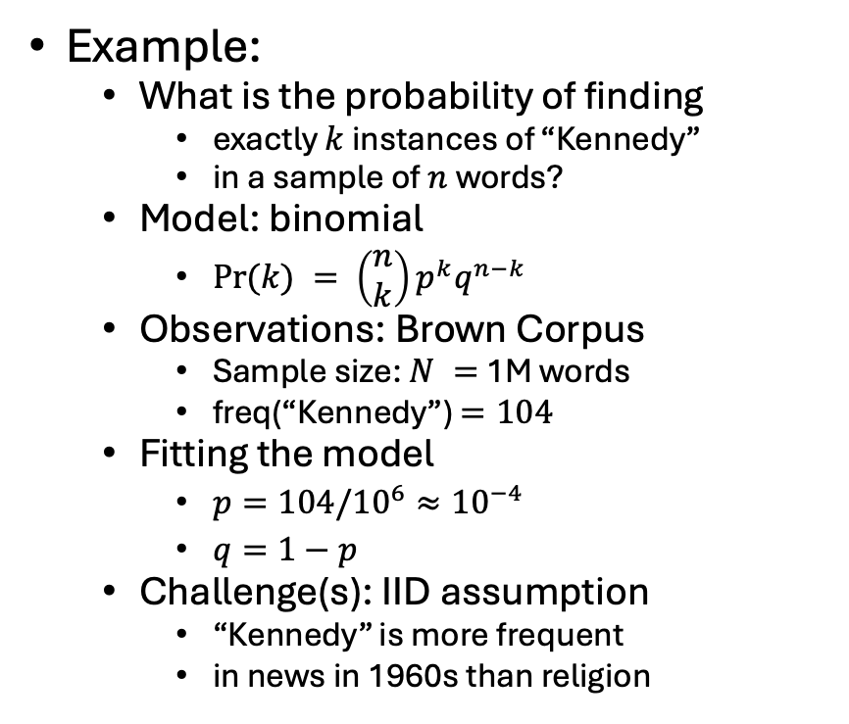
Statistics: Combining Models with Observations
Models (from Probability)
Binomial
Multinomial
Normal
Poisson
Exponential
Observations: Corpora
Assumptions: IID
https://en.wikipedia.org/wiki/Independent_and_identically_distributed_random_variables
Example:
What is the probability of finding
exactly $k$ instances of “Kennedy”
in a sample of $n$ words?
Model: binomial
$Pr⁡(k) = \left(\begin{matrix}n \\ k\end{matrix}\right)p^{k}q^{n−k}$
Observations: Brown Corpus
Sample size: $N =$ 1M words
freq(“Kennedy”) $=104$
Fitting the model
$p=104/{10}^{6}≈{10}^{−4}$
$q=1−p$
Challenge(s): IID assumption
“Kennedy” is more frequent
in news in 1960s than religion

Slide 34
Freq depends on many factors, e.g, genre, time

Slide 35
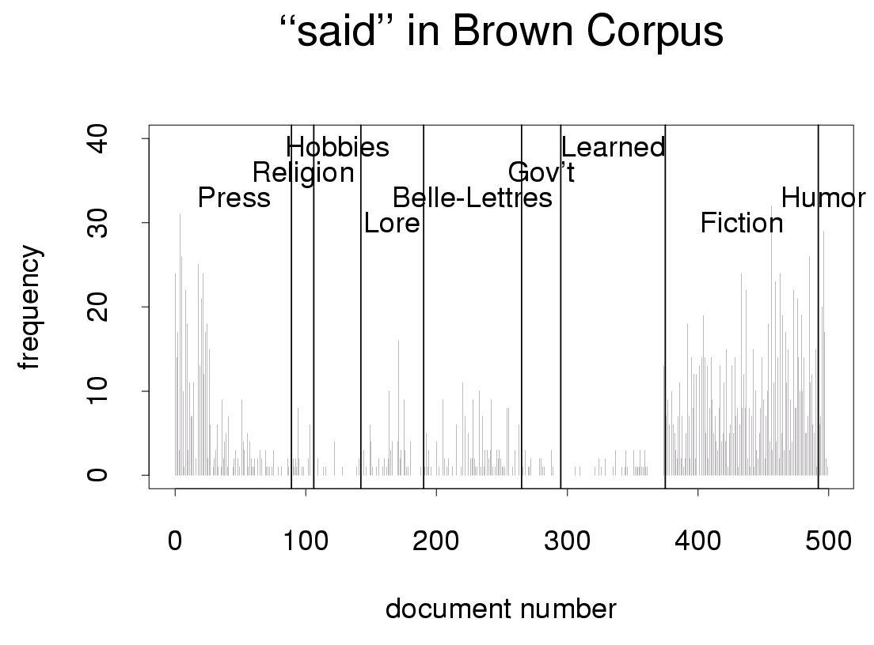
Freq depends on news type (reportage vs. editorial)

Slide 36
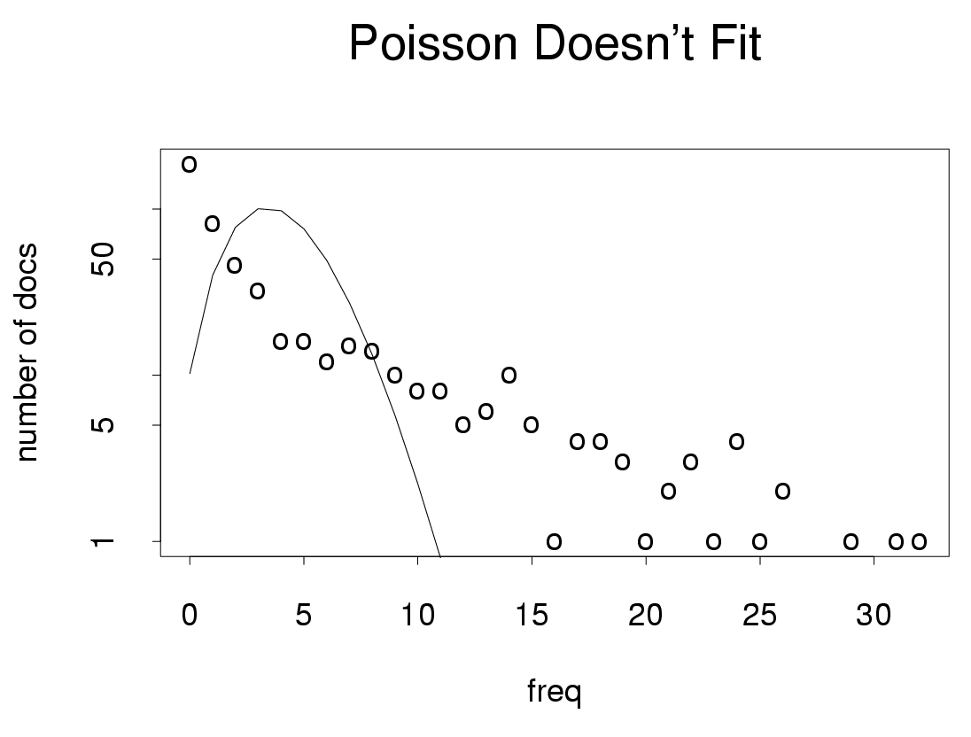
Burstiness
Freq depends many hidden variables

Slide 37
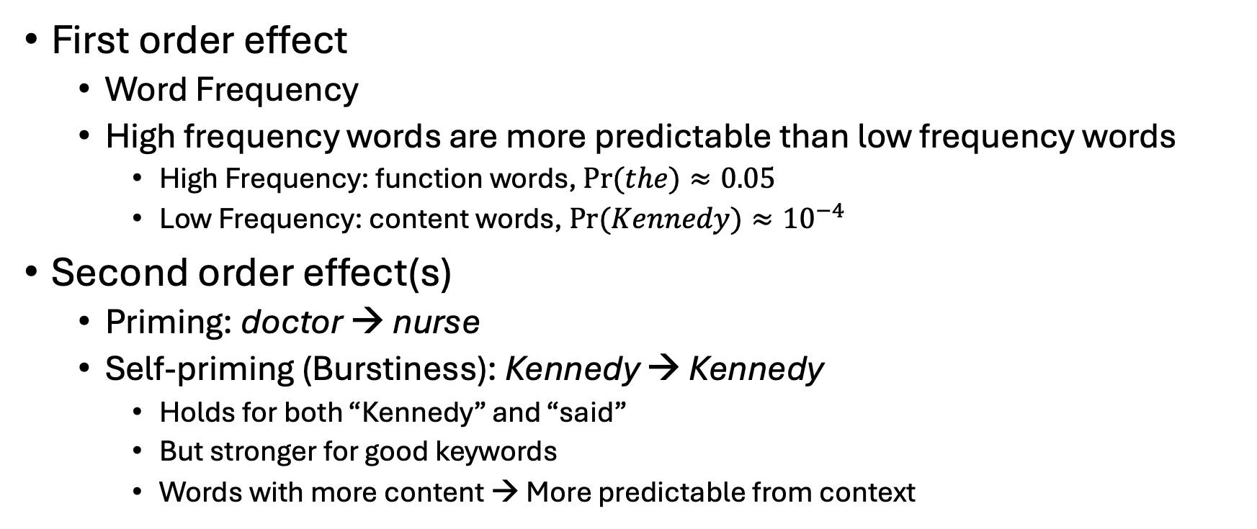
Priming & Self-Priming (Burstiness)
First order effect
Word Frequency
High frequency words are more predictable than low frequency words
High Frequency: function words, $Pr⁡(the)≈0.05$
Low Frequency: content words, $Pr⁡(Kennedy)≈{10}^{−4}$
Second order effect(s)
Priming: doctor → nurse
Self-priming (Burstiness): Kennedy → Kennedy
Holds for both “Kennedy” and “said”
But stronger for good keywords
Words with more content → More predictable from context

Slide 38
Agenda
Lexical Semantics
Word Associations
Information Theory
Computational Linguistics
Corpora
PMI: Connecting the dots
Bots: Past → Present → Future

Slide 39
Lexical Semantics

Slide 40
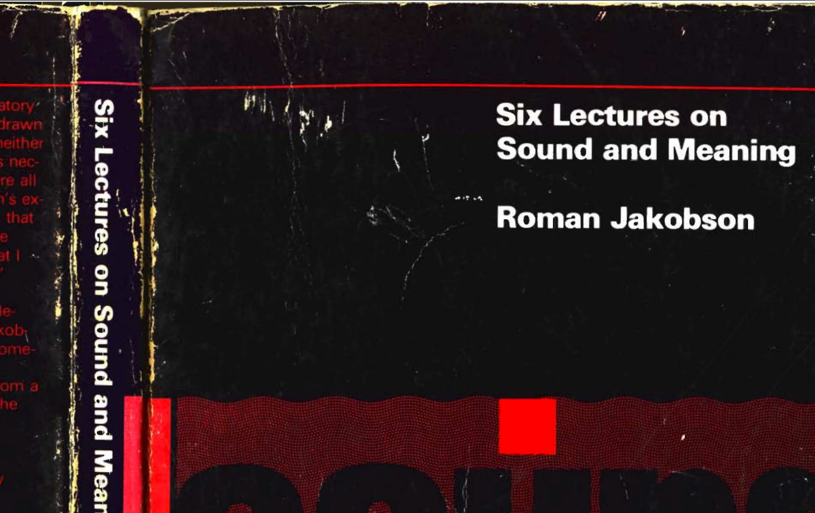
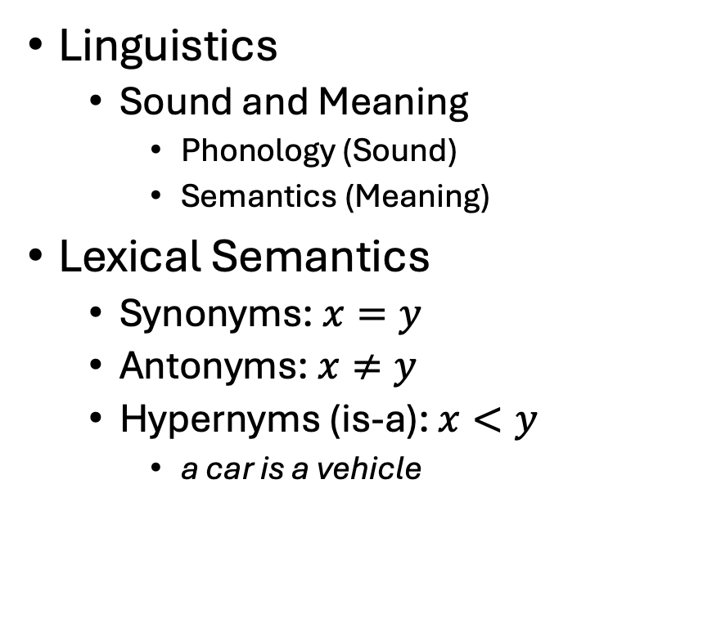
Vectors →Lexical Semantics
Linguistics
Sound and Meaning
Phonology (Sound)
Semantics (Meaning)
Lexical Semantics
Synonyms: $x=y$
Antonyms: $x≠y$
Hypernyms (is-a): $x<y$
a car is a vehicle
Related Topics
Ontologies
Semantic Networks
WordNet
Vectors/Embeddings:
More modern view of meaning
Behind much of the recent excitement in AI
Large Language Models (LLM)
Bots: ChatGPT, DeepSeek
Equivalence Relation
Partial Order

Slide 41
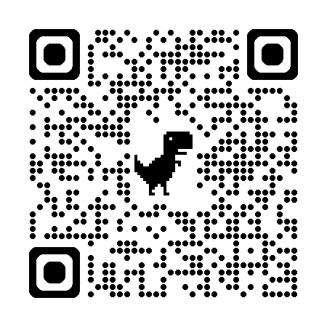
So far
Jurafsky’s Slide 17
Word-Sense Disambiguation (WSD)
Concepts or word senses
Have a complex many-to-many association with words (homonymy, multiple senses)
Have relations with each other
Synonymy
Antonymy
Similarity
Relatedness
Connotation
Collocations
Collocations
Collocations
Collocations
Collocations
Large PMI
https://web.stanford.edu/~jurafsky/slp3/slides/vectorsemantics2024.pdf

Slide 42
Collocations: Examples >> Definitions (George Miller: Chomsky’s Mentor & WordNet)
Exercise: Use “erode” in a sentence:
My family erodes a lot.
to eat into or away; destroy by slow consumption or disintegration
Battery acid had eroded the engine.
Inflation erodes the value of our money.
Miller’s Conclusion:
Dictionary examples are more helpful than definitions
Effective examples:
Make heavy use of collocations
Definition
Examples
6/27/2014
Fillmore Workshop
42

Slide 43
Corpus-Based Lexicography
Examples should be “natural”
Based on corpus evidence
Avoid temptation to make up examples
Representative (sorted by frequency)
Classify concordances by sense (collocates)
Sort senses by frequency

Slide 44
Corpus-Based Methods Lexicography → Engineering
Collect a sample of text (corpus)
Brown Corpus
British National Corpus (BNC)
Create Concordances
Also known as key word in context (KWIC)
Identify collocations
Organize concordances into patterns
Save <good> from <bad>

Slide 45
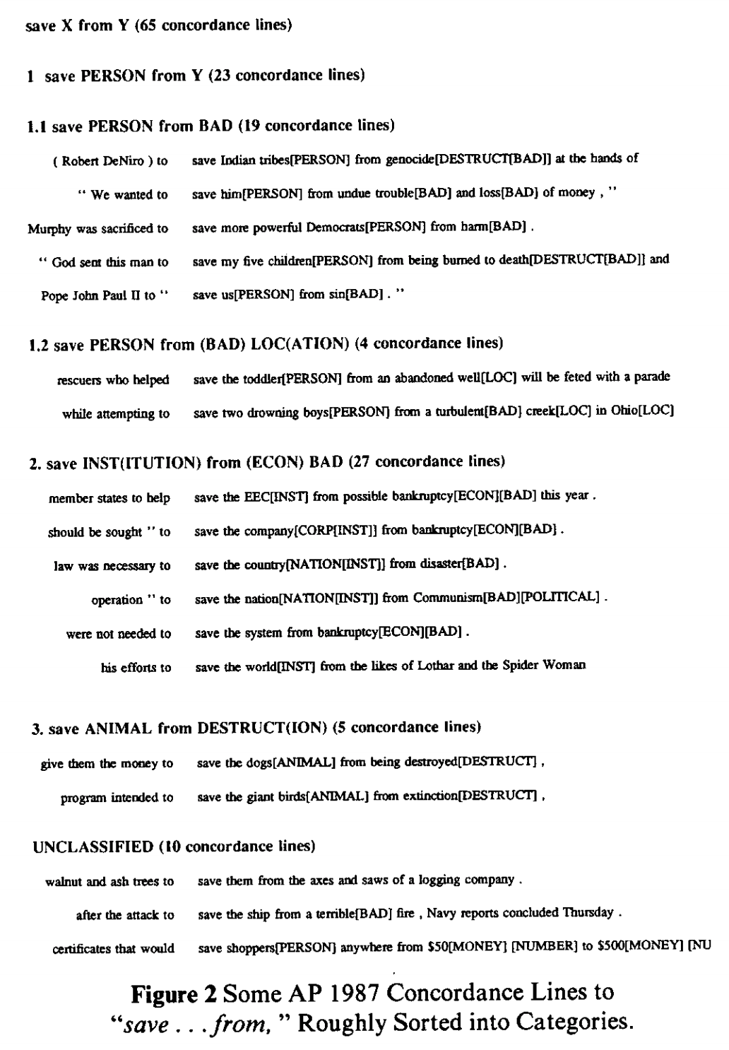
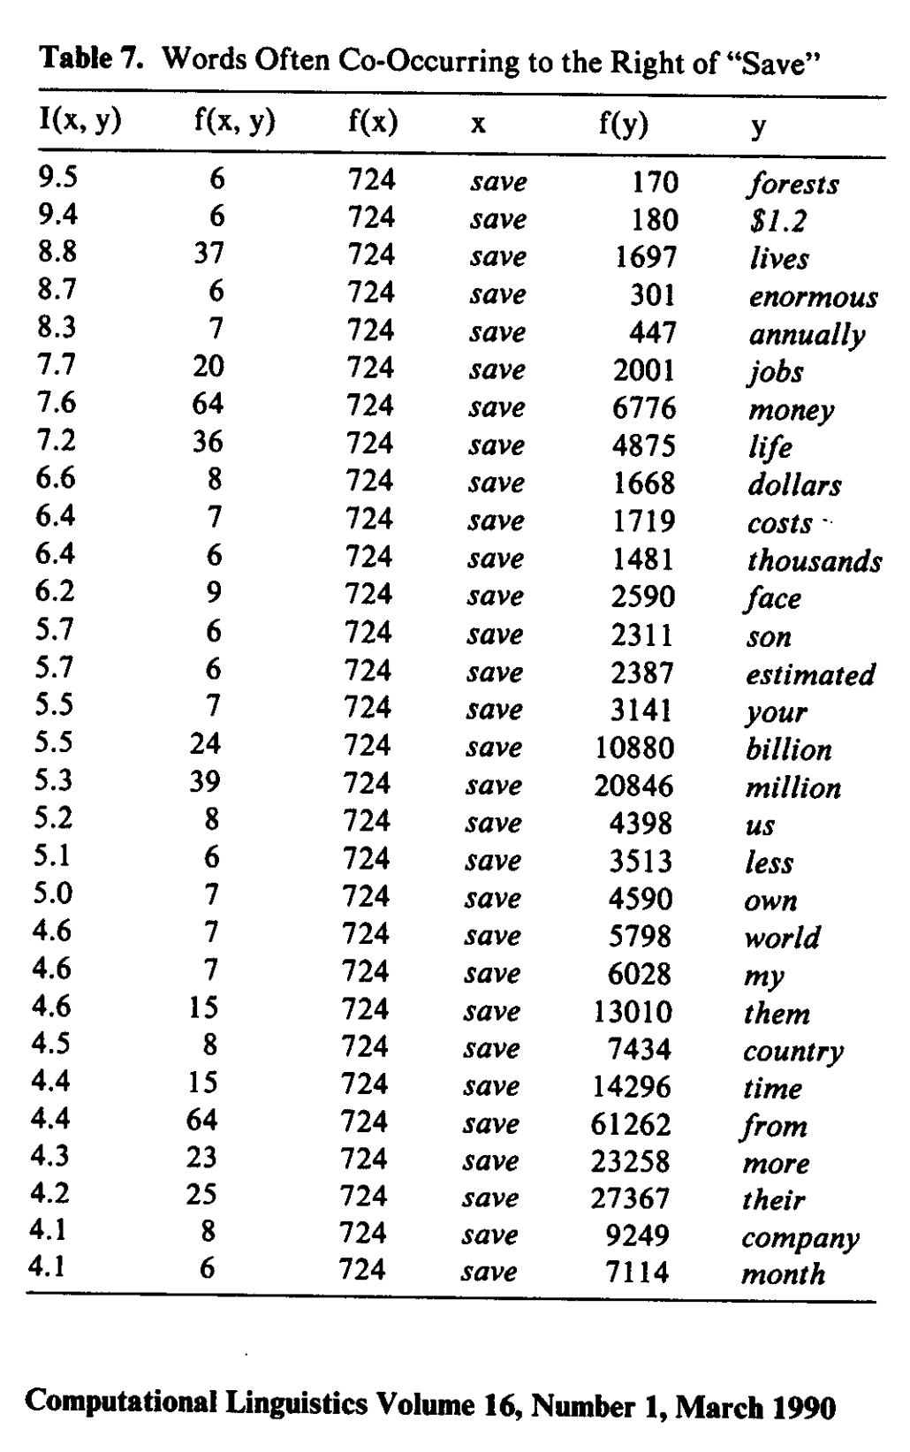
Save <good> from <bad>

Slide 46
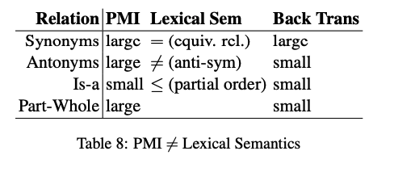

PMI $≠$ Lexical Semantics $≠$ Back Translation
PMI estimates collocations
Probability that two words
appear near one another,
normalized by chance
good / OK / bad
Back Translation
Random walk over translations
Good → Bien → OK
But not, good → … → bad
Large PMI
Collocations:
Truth, Justice & American Way
Red, White and Blue
Synonyms: true / correct
Antonyms: true / false
Part-Whole: window /house

Slide 47
Agenda
Lexical Semantics
Word Associations
Information Theory
Computational Linguistics
Corpora
PMI: Connecting the dots
Bots: Past → Present → Future

Slide 48
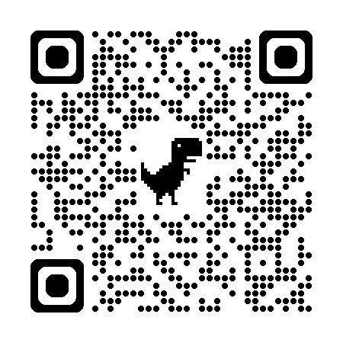

Word Associations https://wordassociation.org/

Slide 49
https://en.wikipedia.org/wiki/Gestalt_psychology
“atomism,” also known as “elementalism,’’
the view that all knowledge, even complex abstract ideas, is built from simple, elementary constituents
“sensationalism,”
the view that the simplest constituents—the atoms of thought—are elementary sense impressions
“associationism,”
the view that more complex ideas arise
from the association of simpler ideas.
PMI: Word Associations

Slide 50



Priming & Word Associations Task: Subject is given two strings and responds “yes” if both are words

Slide 51

Size of Priming Effect (Split Second): 855 msec v. 940 msec (from previous slide)
System 1 vs System 2
Fast (Unconscious)
Slow
Rules of Thumb
500 msec:
Push a button after tone
1000 msec: Lexical retrieval
Push one button for words and another button for non-words
Longer: System 2
Explain your work

Slide 52
Thinking Fast and Slow Quoted from (pp. 20-21)
System 1 operates automatically and quickly,
with little or no effort and
no sense of voluntary control.
System 2 allocates attention to the effortful mental activities that demand it, including complex computations.
The operations of System 2 are often associated with the subjective experience of agency, choice, and concentration.

Slide 53
Consequences for Artificial Intelligence (AI)
Recent excitement in AI
Large Language Models (LLMs)
Deep Networks
ChatBots (ChatGPT)
RAG
Thus far, AI is more effective
for System 1 than System 2
What about bots for programming?
That sounds like a System 2 task
But bots program by table lookup
More like lexical retrieval
than problem solving
Interpretability: open problem
Bots find it hard to explain their work
Just as people find it hard to explain
what happens during lexical retrieval

Slide 54
Jurafsky’s Slides
with my comments

Slide 55
Relation: Similarity
Words with similar meanings. Not synonyms, but sharing some element of meaning
car, bicycle
cow, horse
Notes:
While words don’t have many synonyms, most words do have lots of similar words. Cat is not a synonym of dog, but cats and dogs are certainly similar words. The notion of word similarity is very useful in larger semantic tasks. Know- ing how similar two words are can help in computing how similar the meaning of two phrases or sentences are, a very important component of natural language un- derstanding tasks like question answering, paraphrasing, and summarization.

Slide 56
Ask humans how similar 2 words are
word1 | word2 | similarity
vanish | disappear | 9.8
behave | obey | 7.3
belief | impression | 5.95
muscle | bone | 3.65
modest | flexible | 0.98
hole | agreement | 0.3
SimLex: A popular benchmark
SimLex-999 dataset (Hill et al., 2015)
Notes:
One way of getting values for word similarity is to ask humans to judge how similar one word is to another. A number of datasets have resulted from such experiments. For example the SimLex-999 dataset (Hill et al., 2015) gives values on a scale from 0 to 10, from near-synonyms (vanish, disappear) to pairs that scarcely seem to have anything in common (hole, agreement):

Slide 57
Relation: Word relatedness
Word Association Norms:
Published summaries of fill-in-the-blank experiments
Also called "word association"
Words can be related in any way, perhaps via a semantic frame or field
coffee, tea: similar
coffee, cup: related, not similar
Notes:
The meaning of two words can be related in ways other than similarity. One such class of connections is called word relatedness (Budanitsky
and Hirst, 2006), also traditionally called word association in psychology. Coffee is similar to tea. But coffee is not similar to cup; they share practically no features (coffee is a plant or a beverage, while a cup is a manufactured object with a particular shape). But coffee and cup are clearly related; they are associated by co-participating in an everyday event (the event of drinking coffee out of a cup). Similarly scalpel and surgeon are not similar but are related
eventively (a surgeon tends to make use of a scalpel).

Slide 58
Semantic field
Similar to Topic Clustering
Words that
cover a particular semantic domain
bear structured relations with each other.
hospitals
surgeon, scalpel, nurse, anaesthetic, hospital
restaurants
waiter, menu, plate, food, menu, chef
houses
door, roof, kitchen, family, bed
Notes:
One common kind of relatedness between words is if they belong to the same
semantic field. A semantic field is a set of words which cover a particular semantic domain and bear structured relations with each other. For example, words might be related by being in the semantic field of hospitals (surgeon, scalpel, nurse, anes- thetic, hospital), restaurants (waiter, menu, plate, food, chef), or houses (door, roof, kitchen, family, bed).

Slide 59
Relation: Antonymy
Senses that are opposites with respect to only one feature of meaning
Otherwise, they are very similar!
dark/light short/long fast/slow rise/fall
hot/cold up/down in/out
More formally: antonyms can
define a binary opposition or be at opposite ends of a scale
long/short, fast/slow
Be reversives:
rise/fall, up/down

Slide 60
Connotation (sentiment)
Emotion Classification
Words have affective meanings
Positive connotations (happy)
Negative connotations (sad)
Connotations can be subtle:
Positive connotation: copy, replica, reproduction
Negative connotation: fake, knockoff, forgery
Evaluation (sentiment!)
Positive evaluation (great, love)
Negative evaluation (terrible, hate)
Sentiment Classification
Notes:
Finally, words have affective meanings or connotations. The word connotation has different meanings in different fields, but here we use it to mean the aspects of a word’s meaning that are related to a writer or reader’s emotions, sentiment, opinions, or evaluations. For example some words have positive conno- tations (happy) while others have negative connotations (sad). Even words whose meanings are similar in other ways can vary in connotation; consider the difference in connotations between fake, knockoff, forgery, on the one hand, and copy, replica, reproduction on the other
Some words describe positive evaluation (great, love) and others neg- ative evaluation (terrible, hate). Positive or negative evaluation language is called sentiment, as we saw already, and word sentiment plays a role in important tasks like sentiment analysis, stance detection, and applications of NLP to the lan- guage of politics and consumer reviews.

Slide 61

Connotation
VAD: Represent words as 3D vectors
$$sim\left(x,y\right)=cos⁡(x,y)$$
Osgood et al. (1957)
Words seem to vary along 3 affective dimensions:
valence: the pleasantness of the stimulus
arousal: the intensity of emotion provoked by the stimulus
dominance: the degree of control exerted by the stimulus
 | Word | Score |  | Word | Score
Valence | love | 1.000 |  | toxic | 0.008
 | happy | 1.000 |  | nightmare | 0.005
Arousal | elated | 0.960 |  | mellow | 0.069
 | frenzy | 0.965 |  | napping | 0.046
Dominance | powerful | 0.991 |  | weak | 0.045
 | leadership | 0.983 |  | empty | 0.081
Values from NRC VAD Lexicon (Mohammad 2018)
Notes:
Early work on affective meaning (Osgood et al., 1957) found that words varied along three important dimensions of affective meaning:

Slide 62


Connotation
VAD: Represent words as 3D vectors
$$sim\left(x,y\right)=cos⁡(x,y)$$
Osgood et al. (1957)
Words seem to vary along 3 affective dimensions:
valence: the pleasantness of the stimulus
arousal: the intensity of emotion provoked by the stimulus
dominance: the degree of control exerted by the stimulus
20k English words
(with glosses in many languages)
Pivoting via English introduces Anglocentric biases
Values from NRC VAD Lexicon (Mohammad 2018)
Notes:
Early work on affective meaning (Osgood et al., 1957) found that words varied along three important dimensions of affective meaning:

Slide 63
So far
Repeat of Jurafsky’s Slide 17
Word-Sense Disambiguation (WSD)
Concepts or word senses
Have a complex many-to-many association with words (homonymy, multiple senses)
Have relations with each other
Synonymy
Antonymy
Similarity
Relatedness
Connotation
SimLex Benchmark
Word Associations
VAD
https://web.stanford.edu/~jurafsky/slp3/slides/vectorsemantics2024.pdf

Slide 64
Agenda
Lexical Semantics
Word Associations
Information Theory
Computational Linguistics
Corpora
PMI: Connecting the dots
Bots: Past → Present → Future

Slide 65
Information Theory

Slide 66


Pointwise Mutual Information (PMI)
PMI has a simple interpretation
$\operatorname{Pr}\left(x\right)≈\frac{f\left(x\right)}{N}$
$\operatorname{Pr}\left(y\right)≈\frac{f\left(y\right)}{N}$
$\operatorname{Pr}\left(x,y\right)≈\frac{f\left(x,y\right)}{N}$
PMI compares P(x,y) with chance
Chance $= P(x) P(y)$
If there is a genuine association
then $P(x,y) ≫ P(x) P(y)$
Uninteresting associations
$P(x,y) ≈ P(x) P(y)$

Slide 67

Pointwise Mutual Information (PMI)
Entropy:
$H\left(X\right)=−\sum_{x∈X}{p\left(x\right)\log_{2}}p\left(x\right)$
Mutual Information
$I\left(X;Y\right)=H\left(X\right)−H\left(X | Y\right)$
$I\left(Y;X\right)=H\left(Y\right)−H(Y|X)$
Properties:
Symmetry $I\left(X;Y\right)=I(Y;X)$
Non-negative: $I(X;Y)≥0$
Pointwise

Slide 68


Pointwise Mutual Information (PMI)
PMI has a simple interpretation
PMI compares P(x,y) with chance
Chance = P(x) P(y)
If there is a genuine association
then P(x,y) >> P(x) P(y)
Uninteresting associations
P(x,y) ≈ P(x) P(y)
Entropy:
$H\left(X\right)=−\sum_{x∈X}{p\left(x\right)\log_{2}}p\left(x\right)$
Mutual Information
$I\left(X;Y\right)=H\left(X\right)−H\left(X | Y\right)$
$I\left(X;Y\right)=H\left(Y\right)−H(Y|X)$
Properties:
Symmetry $I\left(X;Y\right)=I(Y;X)$
Non-negative: $I(X;Y)≥0$
Pointwise

Slide 69



Slide 70



Telephone
$$X$$
$$Y$$

Slide 71

Telephone
Gzip

Slide 72


Slide 73

Perplexity & Entropy
Lexical Retrieval
Perplexity $2^{H(x)}$: Summary of number of guesses
Entropy $H\left(x\right)$: Number of bits required to store $x$
Bandwidth of a communication channel
$H\left(X\right)=−\sum{p\log_{2} p}$
Gzip

Slide 74

Zipf’s Law: $freq \sim \frac{1}{rank}$
Function Words
Non-uniform probabilities → Opportunities for compression
Content Words

Slide 75
Agenda
Lexical Semantics
Word Associations
Information Theory
Computational Linguistics
Corpora
PMI: Connecting the dots
Bots: Past → Present → Future

Slide 76

PMI → Word2Vec
Word2Vec: Represent words as vectors
Embed words in a vector space
$sim(x,y) ≈ cos⁡(x,y)$
Dimension Reduction
Singular Value Decomposition (SVD)
Connect the dots with PMI
Motivation for embeddings
Visualization
Semantic types: cities vs. countries
Analogies

Slide 77


SVD: Singular Value Decomposition
 | c1 | c2 | c3 | c4 | c5 | m1 | m2 | m3 | m4
human | 1 | 0 | 0 | 1 | 0 | 0 | 0 | 0 | 0
interface | 1 | 0 | 1 | 0 | 0 | 0 | 0 | 0 | 0
computer | 1 | 1 | 0 | 0 | 0 | 0 | 0 | 0 | 0
user | 0 | 1 | 1 | 0 | 1 | 0 | 0 | 0 | 0
system | 0 | 1 | 1 | 2 | 0 | 0 | 0 | 0 | 0
response | 0 | 1 | 0 | 0 | 1 | 0 | 0 | 0 | 0
time | 0 | 1 | 0 | 0 | 1 | 0 | 0 | 0 | 0
EPS | 0 | 0 | 1 | 1 | 0 | 0 | 0 | 0 | 0
survey | 0 | 1 | 0 | 0 | 0 | 0 | 0 | 0 | 1
trees | 0 | 0 | 0 | 0 | 0 | 1 | 1 | 1 | 0
graph | 0 | 0 | 0 | 0 | 0 | 0 | 1 | 1 | 1
minors | 0 | 0 | 0 | 0 | 0 | 0 | 0 | 1 | 1
M: term by doc matrix
$M≈UDV^{T}$
Dimension Reduction
U,D,Vt = np.linalg.svd(M)
$\hat{M}=U@\text{np}\text{.}\text{diag}(D)@V^{T}$
Dimension reduction
D[2:]=0
$\hat{M}=U@\text{np}\text{.}\text{diag}(D)@V^{T}$

Slide 78


plot(hclust(as.dist(1-cor(m)))
 | c1 | c2 | c3 | c4 | c5 | m1 | m2 | m3 | m4
human | 1 | 0 | 0 | 1 | 0 | 0 | 0 | 0 | 0
interface | 1 | 0 | 1 | 0 | 0 | 0 | 0 | 0 | 0
computer | 1 | 1 | 0 | 0 | 0 | 0 | 0 | 0 | 0
user | 0 | 1 | 1 | 0 | 1 | 0 | 0 | 0 | 0
system | 0 | 1 | 1 | 2 | 0 | 0 | 0 | 0 | 0
response | 0 | 1 | 0 | 0 | 1 | 0 | 0 | 0 | 0
time | 0 | 1 | 0 | 0 | 1 | 0 | 0 | 0 | 0
EPS | 0 | 0 | 1 | 1 | 0 | 0 | 0 | 0 | 0
survey | 0 | 1 | 0 | 0 | 0 | 0 | 0 | 0 | 1
trees | 0 | 0 | 0 | 0 | 0 | 1 | 1 | 1 | 0
graph | 0 | 0 | 0 | 0 | 0 | 0 | 1 | 1 | 1
minors | 0 | 0 | 0 | 0 | 0 | 0 | 0 | 1 | 1

Slide 79

plot(hclust(as.dist(1-cor(t(m))))
 | c1 | c2 | c3 | c4 | c5 | m1 | m2 | m3 | m4
human | 1 | 0 | 0 | 1 | 0 | 0 | 0 | 0 | 0
interface | 1 | 0 | 1 | 0 | 0 | 0 | 0 | 0 | 0
computer | 1 | 1 | 0 | 0 | 0 | 0 | 0 | 0 | 0
user | 0 | 1 | 1 | 0 | 1 | 0 | 0 | 0 | 0
system | 0 | 1 | 1 | 2 | 0 | 0 | 0 | 0 | 0
response | 0 | 1 | 0 | 0 | 1 | 0 | 0 | 0 | 0
time | 0 | 1 | 0 | 0 | 1 | 0 | 0 | 0 | 0
EPS | 0 | 0 | 1 | 1 | 0 | 0 | 0 | 0 | 0
survey | 0 | 1 | 0 | 0 | 0 | 0 | 0 | 0 | 1
trees | 0 | 0 | 0 | 0 | 0 | 1 | 1 | 1 | 0
graph | 0 | 0 | 0 | 0 | 0 | 0 | 1 | 1 | 1
minors | 0 | 0 | 0 | 0 | 0 | 0 | 0 | 1 | 1

Slide 80


LSA maps terms & docs into internal dimensions

Slide 81


Similarity Matrix (S) → Embedding (Z)
Similarity of columns
Similarity of rows
$\hat{M}=UDV^{T}$
$S_{1} = M M^{T}$
$S_{1}≈Z Z^{T}$
where $Z=U D$
Embedding
$Z∈ℛ^{n×d}$
$n$: rows of $\hat{M}$ (# of docs)
$d$: hidden dimensions
dimension reduction: $d≪n$
$\hat{M}=UDV^{T}$
${\hat{M}}^{T}$=$VDU^{T}$
$S_{2} = M^{T}M$
$S_{2}≈Z Z^{T}$
where $Z=V D$
Embedding
$Z∈ℛ^{n×d}$
$n$: columns of $\hat{M}$ (# of words in vocab)
$d$: hidden dimensions
dimension reduction: $d≪n$

Slide 82

PMI Matrix (S) → Embedding (Z)
Let $S$ be a PMI matrix
where $S∈ℛ^{vxv}$
$S$ is symmetric
$v$: # of words in vocabulary
$S=UDV^{T}$
$S$ $≈Z Z^{T}$
where $Z=U \sqrt{D}$
Embedding
$Z∈ℛ^{v×d}$
dimension reduction: $d≪v$

Slide 83



Word2Vec: $sim\left(x,y\right)=\cos\left(vec\left(x\right), vec\left(y\right)\right)≈PMI(x,y)$ https://code.google.com/archive/p/word2vec/
Linguistic generalizations
Word associations (dist in plot)
Features (red line)
Countries & Capitals
Analogies:
Man : Woman :: King : x
x → queen
Athens : Greece :: Bangkok: x
x → Thailand

Slide 84


man : woman :: king : x
Vector addition & subtraction
$vec\left(king+woman −man\right)=vec\left(king\right)+vec\left(woman\right)−vec(man)$
Analogies
$\hat{x}=\underset{x∈V}{ARGMAX}{sim(x^{′}, king+woman −man)}$
Near misses

Slide 85

Some analogies are easier than others
Tweets
RT @tallinzen: sure, king:queen etc, but did you know word2vec gets real SAT analogies right just 1% of the time?
15 copies of this tweet
Some by NLP experts
Resources Debate
WordNet &
British National Corpora

Slide 86

Levy & Goldberg (NIPS-2014) Word2Vec ≈ PMI (Pointwise Mutual Info)
Levy & Goldberg (NIPS-2014) is a theoretical arg
Plots → correlations are large, but far from perfect
Materials:
N = 22 words (11 cities + 11 countries)
N (N-1)/2 = 231 pairs of words (points)
type in {city, country}
Color:
Green → type match
Red → type mismatch

Slide 87
Backup

Slide 88


Jurafsky’s Spin on This History Jurafsky is author of Textbook (and “foodie”)

Slide 89
Topics to be discussed today
Motivations for PMI in
Lexicography (Hanks): Collocations
Engineering (Church): Bots
Use PMI as a foil to discuss
Past (1950s)
Psycholinguistics (Word Associations, Reaction Times)
Information Theory (Entropy, Perplexity)
Corpus-Based Methods (Lexicography → Engineering)
Future (Bots)
Vectors
Approximate Nearest Neighbors (ANN)

Slide 90




End-to-End Self-Organizing Systems v. Human-in-the-Loop
Collaboration with Hanks (PMI)
We always assumed
computer was in a supporting role.
It was my job to speed up drudgery
of reading concordances,
but it was not my job
to automate his job.
He loved most of what he did,
though he was happy to work with me to automate a few unpleasant chores,
so he could spend more time on the parts of his job that he truly enjoyed.
I am concerned that we are too carried away with the upsides
Too much talk about firing linguists,
and replacing historians like Platt and
lexicographers like Hanks with automation.
Bots can already do many things,
and they will get better,
but bots cannot – and should not attempt to – do more than they can do.

Slide 91

http://www.lrec-conf.org/lrec2004/doc/jelinek.pdf

Slide 92

Robert Mercer ACL Lifetime Achievement http://techtalks.tv/talks/closing-session/60532/

Slide 93




The Disk Space Conjecture
Improvements in Speech, Language (& more)
are indexed to improvements in disk capacities
because disk prices → size of web → training data
2003 Prediction:
Disks improve1000x per decade
1TB: $1k (2003) → $1 (2013)
Missed by 30x (a TB is currently ~ $30 >> $1)

Slide 94

Disk Prices Over 30 Years http://www.jcmit.com/diskprice.htm
191x cheaper per decade (1985-2014)
1750x cheaper per decade (1995-2003)
Flood

Slide 95
Moore’s Law: Different Time Constants for Different Things https://archive.is/3pgVP

Slide 96
Word Association Norms: Doctor / Nurse
Counts are growing 1000x per decade
(same as disks)
Counts are growing 1000x per decade
(same as disks)
Rising Tide of Data Lifts All Boats

Slide 97
Priming & Word Associations Task: Subject is given two strings and responds “yes” if both are words

Slide 98

Pointwise Mutual Information (PMI)
Simple interpretation
PMI compares P(x,y) with chance
Chance = P(x) P(y)
If there is a genuine association
then P(x,y) >> P(x) P(y)
Uninteresting associations
P(x,y) ≈ P(x) P(y)
Popular applications (lexicography)
more like hypothesis testing
focus on largest PMI
where we can reject null hypothesis
null hypo: uninteresting
less like language modeling for speech and machine translation

Slide 99

Windows for computing P(x,y)
Bigrams:
rectangular window with width of 1 word
Ngrams
rectangular window with width of n-1 words
More generally
Windows need not be rectangular
Or symmetric around 0
(Mutual Information is symmetric
but “Association Measure” is not)
Convenient to assume windows sum to 1
More interesting windows
Parse Trees / SVO

Slide 100


OCR Application

Slide 101


Applications in Lexicography

Slide 102



Proper Place for Automation: Start with Drudgery (Support our colleagues; don’t talk too much about taking away jobs they love to do)

Slide 103

Patrick found tables like this very exciting

Slide 104
Save <good> from <bad>

Slide 105
Save good shoppers from their evil $$
Patrick wanted me to “fix” my bug

Slide 106

https://books.google.com/ngrams/graph?content=save+forests+from%2Csave+whales+from%2Csave+the+planet+from%2Csave+the+environment+from&year_start=1800&year_end=2000&corpus=15&smoothing=3&share=&direct_url=t1%3B%2Csave%20forests%20from%3B%2Cc0%3B.t1%3B%2Csave%20whales%20from%3B%2Cc0%3B.t1%3B%2Csave%20the%20planet%20from%3B%2Cc0%3B.t1%3B%2Csave%20the%20environment%20from%3B%2Cc0
Google Ngrams

Slide 107

save from ≠ save X from Y

Slide 108

save from ≠ save X from Y

Slide 110
Plan
Summarize main points of paper
Call out
some highlights of subsequent literature
suggestions for future work

Slide 111

Using Google Scholar to find subsequent work to call out
Text Classification
LSA
Sentiment
Sentiment
Lexicography

Slide 112



Levy & Goldberg (NIPS-2014) Word2Vec ≈ PMI (Pointwise Mutual Info) $sim\left(x,y\right)=\cos\left(vec\left(x\right), vec\left(y\right)\right)≈PMI(x,y)$
What happened in 2014?

Slide 113
Word2vec is popular (massively cited)
Word2vec is not first, last or best to discuss
Vector spaces, embeddings, analogies, similarity metrics, etc.
But word2vec is simple and accessible
Anyone can download the code and use it in their next paper.
Any many do (for better and for worse)
Available downloads
Pre-computed vectors (no training required)
Code for training your own vectors on your own corpora

Slide 114

Salton’s Vector Space Model

Slide 115

Embeddings: Similarity of docs/words ≈ cos (dot product)

Slide 116

Information Retrieval (IR) notation Term Weighting: tf * IDF
t: term
d: document
D: # of documents in library
tf(t,d): term frequency
# of times that t appears in d
df(t): document frequency
# of documents that contain t
(at least once)
IDF(t): inverse doc frequency
$IDF\left(t\right)=−\log_{2}\frac{df(t)}{D}$
tf * IDF weighting
Assumes (too much) indep

Slide 118

LSA/LSI: Latent Semantic Analysis/Indexing SVD: Singular Value Decomposition PCA: Principal Component Analysis
 | c1 | c2 | c3 | c4 | c5 | m1 | m2 | m3 | m4
human | 1 | 0 | 0 | 1 | 0 | 0 | 0 | 0 | 0
interface | 1 | 0 | 1 | 0 | 0 | 0 | 0 | 0 | 0
computer | 1 | 1 | 0 | 0 | 0 | 0 | 0 | 0 | 0
user | 0 | 1 | 1 | 0 | 1 | 0 | 0 | 0 | 0
system | 0 | 1 | 1 | 2 | 0 | 0 | 0 | 0 | 0
response | 0 | 1 | 0 | 0 | 1 | 0 | 0 | 0 | 0
time | 0 | 1 | 0 | 0 | 1 | 0 | 0 | 0 | 0
EPS | 0 | 0 | 1 | 1 | 0 | 0 | 0 | 0 | 0
survey | 0 | 1 | 0 | 0 | 0 | 0 | 0 | 0 | 1
trees | 0 | 0 | 0 | 0 | 0 | 1 | 1 | 1 | 0
graph | 0 | 0 | 0 | 0 | 0 | 0 | 1 | 1 | 1
minors | 0 | 0 | 0 | 0 | 0 | 0 | 0 | 1 | 1
M: term by doc matrix
$M≈UDV^{T}$
Dimension Reduction
s = svd(m)
m2 = s$u[,1:2] %*% diag(s$d[1:2]) %*% t(s$v[,1:2])
dimnames(m2)=dimnames(m)
Bellcore Example

Slide 119


Slide 120
plot(hclust(as.dist(1-cor(m)))
 | c1 | c2 | c3 | c4 | c5 | m1 | m2 | m3 | m4
human | 1 | 0 | 0 | 1 | 0 | 0 | 0 | 0 | 0
interface | 1 | 0 | 1 | 0 | 0 | 0 | 0 | 0 | 0
computer | 1 | 1 | 0 | 0 | 0 | 0 | 0 | 0 | 0
user | 0 | 1 | 1 | 0 | 1 | 0 | 0 | 0 | 0
system | 0 | 1 | 1 | 2 | 0 | 0 | 0 | 0 | 0
response | 0 | 1 | 0 | 0 | 1 | 0 | 0 | 0 | 0
time | 0 | 1 | 0 | 0 | 1 | 0 | 0 | 0 | 0
EPS | 0 | 0 | 1 | 1 | 0 | 0 | 0 | 0 | 0
survey | 0 | 1 | 0 | 0 | 0 | 0 | 0 | 0 | 1
trees | 0 | 0 | 0 | 0 | 0 | 1 | 1 | 1 | 0
graph | 0 | 0 | 0 | 0 | 0 | 0 | 1 | 1 | 1
minors | 0 | 0 | 0 | 0 | 0 | 0 | 0 | 1 | 1

Slide 121
plot(hclust(as.dist(1-cor(t(m))))
 | c1 | c2 | c3 | c4 | c5 | m1 | m2 | m3 | m4
human | 1 | 0 | 0 | 1 | 0 | 0 | 0 | 0 | 0
interface | 1 | 0 | 1 | 0 | 0 | 0 | 0 | 0 | 0
computer | 1 | 1 | 0 | 0 | 0 | 0 | 0 | 0 | 0
user | 0 | 1 | 1 | 0 | 1 | 0 | 0 | 0 | 0
system | 0 | 1 | 1 | 2 | 0 | 0 | 0 | 0 | 0
response | 0 | 1 | 0 | 0 | 1 | 0 | 0 | 0 | 0
time | 0 | 1 | 0 | 0 | 1 | 0 | 0 | 0 | 0
EPS | 0 | 0 | 1 | 1 | 0 | 0 | 0 | 0 | 0
survey | 0 | 1 | 0 | 0 | 0 | 0 | 0 | 0 | 1
trees | 0 | 0 | 0 | 0 | 0 | 1 | 1 | 1 | 0
graph | 0 | 0 | 0 | 0 | 0 | 0 | 1 | 1 | 1
minors | 0 | 0 | 0 | 0 | 0 | 0 | 0 | 1 | 1

Slide 122
LSA maps terms & docs into internal dimensions

Slide 123
Word2vec is popular (massively cited)
Word2vec is not first, last or best to discuss
Vector spaces, embeddings, analogies, similarity metrics, etc.
But word2vec is simple and accessible
Anyone can download the code and use it in their next paper.
Any many do (for better and for worse)
Available downloads
Pre-computed vectors (no training required)
Code for training your own vectors on your own corpora

Slide 124
Word2Vec: $sim\left(x,y\right)=\cos\left(vec\left(x\right), vec\left(y\right)\right)≈PMI(x,y)$ https://code.google.com/archive/p/word2vec/
Linguistic generalizations
Word associations (distance in plot)
Features (red line)
Countries & Capitals
Analogies:
Man : Woman :: King : x
x → queen
Athens : Greece :: Bangkok: x
x → Thailand
Vector Space (Salton)
Addition & subtraction
Clustering, PCA
Convenient for Neural Networks

Slide 125
man : woman :: king : x
Vector addition & subtraction
$vec\left(king+woman −man\right)=vec\left(king\right)+vec\left(woman\right)−vec(man)$
Analogies
$\hat{x}=\underset{x∈V}{ARGMAX}{sim(x^{′}, king+woman −man)}$

Slide 126
Some analogies are easier than others
Tweets
RT @tallinzen: sure, king:queen etc, but did you know word2vec gets real SAT analogies right just 1% of the time?
15 copies of this tweet
Some by NLP experts
Resources Debate
WordNet &
British National Corpora

Slide 127
Levy & Goldberg (NIPS-2014) Word2Vec ≈ PMI (Pointwise Mutual Info)
Levy & Goldberg (NIPS-2014) is a theoretical arg
Plots → correlations are large, but far from perfect
Materials:
N = 22 words (11 cities + 11 countries)
N (N-1)/2 = 231 pairs of words (points)
type in {city, country}
Color:
Green → type match
Red → type mismatch

Slide 128

GloVe: https://nlp.stanford.edu/projects/glove/
Alternative to Word2vec:
Similar performance
Both Word2vec & GloVe ≈ PMI
More interpretable:
Neural net → SGD minimization of a sensible loss
More generous license
Both methods output embedding $M$
$M: V$ by $K$ matrix where $M×M^{T}≈P$
$V$: size of vocabulary
$K$: # of internal dimensions
$P$: $V$ by $V$matrix of PMI values
Space: GloVe materializes a $V^{2}$matrix while computing $M$ (unlike Word2vec)

Slide 129

Glass is half-full/empty Word2vec is similar to PMI (but different)

Slide 130
IMHO: Word2vec & GloVe >> PMI
Glass is half full
Levy & Goldberg are correct in pointing out similarities
But half empty
Word2vec & GloVe do better in practice
Because of “tricks” for small counts, etc.
Code is not well understood
Even though there isn’t much there
702 lines in word2vec.c; 446 in glove.c
Dimension Reduction
Matrix completion (?!?)
Obvious suggestion, SVD on PMIs
Disappointing in practice
May not want to model PMI too well

Slide 131


Estimating PMI (and Contingency Tables) Li & Church, Computational Linguistics (2007)
Compute Sample Contingency Table
MLE Inference:
What is the most likely original table
Given sample and margins?
Evaluation
http://stat.rutgers.edu/home/pingli/

Slide 132


Prior Art: Removing (Near) Duplicate Web Pages

Slide 133

Computing Contingency Tables (Brute Force)
5
7
12
7
17
Three constraints
Library: D = a + b + c + d = 36
Margins
f₁ = |P₁| = a + b = 12
f₂ = |P₂| = a + c = 12
a = |P₁ & P₂| = |{4,15, 19, 24, 28}| = 5
b = f₁ – a = 12 – 5 = 7
c = f₂ – a = 12 – 5 = 7
d = D – a – b – c = 36 – 5 – 7 – 7 = 17
12
36
crux
P₁ | 3 | 4 | 7 | 9 | 10 | 15 | 18 | 19 | 24 | 25 | 28 | 33
P₂ | 2 | 4 | 5 | 8 | 15 | 19 | 21 | 24 | 27 | 28 | 31 | 35

Slide 134
Computing Sample Contingency Table (Using Sketches, An Approximation: Yellow)
Key: throw out red {19, 21}
D_{s} = min(max(sketch(w₁)), max(sketch(w₂))) = 18
Can’t tell that 19 is in intersection and 21 is not
Without looking outside the sketch
Ω_{s} = {1, 2,…,D_{s}}
a_{s} = sketch(w₁) & sketch(w₂) & Ω_{s} = |{4,15}| = 2
b_{s} = |sketch(w₁) & Ω_{s}| – a_{s} = 7 – 2 = 5
c_{s} = |sketch(w₂) & Ω_{s}| – a_{s} = 5 – 2 = 3
d_{s} = Ds – a_{s} – b_{s} – c_{s} = 18 – 2 – 5 – 3 = 8
D_{s} = Sample Size
crux
Sketch = Front of Postings
P₁ | 3 | 4 | 7 | 9 | 10 | 15 | 18 | 19 | 24 | 25 | 28 | 33
P₂ | 2 | 4 | 5 | 8 | 15 | 19 | 21 | 24 | 27 | 28 | 31 | 35
Doc IDs need to be random

Slide 135
MLE Inference: What is the most likely table Given sample and margins?
When we know the margins,
We ought to use them
D_{s}/D = Sampling Rate
Consider all possible contingency tables:
a, b, c & d
Select the table that maximizes the probability of observations
a_{s}, b_{s}, c_{s} & d_{s}

Slide 136

Empirical Evaluation MLE >> MF >> Independence
IND (assume independence):
too much error
MF (Margin-Free)
Target: minimize effort & error
D_{s}/D = Sampling Rate (effort)

Slide 137


Non-Empirical Evaluation (Closed Form)
Non-Empirical Evaluation:
MLE has smaller variance than Margin Free (MF) baseline
Confirms Empirical Evaluation:
MLE has less error than MF
When we have margins, we should use them
Improves accuracy as well as consistency

Slide 138
Sketches vs. Word2Vec (as estimates of PMI)
It is said that word2vec is fast
But sketches are also fast
and closer to PMI
But is closer to PMI better?

Slide 139
Interestingness Metrics: Deviations from Independence
Poisson (and other independence assumptions)
Not bad for meaningless random strings
Deviations from Poisson are clues for hidden variables
Meaning, content, genre, topic, author, etc.
Analogous to mutual information (Hanks)
Pr(doctor…nurse) >> Pr(doctor) Pr(nurse)

Slide 143


Adaptation: Three Approaches
Cache-based adaptation
Parametric Models
Poisson, Two Poisson, Mixtures (neg binomial)
Non-parametric
Pr(+adapt₁) ≡ Pr(test|hist)
Pr(+adapt₂) ≡ Pr(k≥2|k ≥1)

Slide 144
Positive & Negative Adaptation
Adaptation:
How do probabilities change as we read a doc?
Intuition: If a word w has been seen recently
+adapt: prob of w (and its friends) goes way up
−adapt: prob of many other words goes down a little
Pr(+adapt) >> Pr(prior) > Pr(−adapt)

Slide 145
Adaptation: Method 1
Split each document into two equal pieces:
Hist: 1st half of doc
Test: 2nd half of doc
Task:
Given hist
Predict test
Compute contingency table for each word
Documents containing hostages in 1990 AP News
 | test
hist | 638 | 505
 | 557 | 76,787

Slide 146
Adaptation: Method 1
 | test
hist | a | b
 | c | d
Notation
D = a+b+c+d (library)
df = a+b+c (doc freq)
Prior:
+adapt
−adapt
Documents containing hostages
Pr(+adapt) >> Pr(prior) > Pr(−adapt)
+adapt | prior | −adapt | source
0.56 | 0.014 | 0.0069 | AP 1987
0.56 | 0.015 | 0.0072 | AP 1990
0.59 | 0.013 | 0.0057 | AP 1991
0.39 | 0.004 | 0.0030 | AP 1993

Slide 147

Adaptation: Hist >> Near >> Prior
Magnitude is huge
Shape: Given/new
1st mention: marked
Surprising (low prob)
Depends on freq
2nd: unmarked
Less surprising
Independent of freq
Priming:
“a little bit” marked

Slide 148
Adaptation: Method 2
Pr(+adapt₂)
df_{k}(w) ≡ number of docs that
mention word w
at least k times
df₁(w) ≡ standard def of document freq (df)

Slide 149
Pr(+adapt₁) ≈ Pr(+adapt₂) Within factors of 2-3 (as opposed to 10-1000)
3rd mention
Priming

Slide 150
Adaptation is Lexical
Lexical: adaptation is
Stronger for good keywords (Kennedy)
Than random strings, function words (except), etc.
Content ≠ low frequency
+adapt | prior | −adapt | source | word
0.27 | 0.012 | 0.0091 | AP90 | Kennedy
0.40 | 0.015 | 0.0084 | AP91 | Kennedy
0.32 | 0.014 | 0.0094 | AP93 | Kennedy
0.049 | 0.016 | 0.016 | AP90 | except
0.048 | 0.014 | 0.014 | AP91 | except
0.048 | 0.012 | 0.012 | AP93 | except

Slide 151
Adaptation Conclusions
Large magnitude (p/2 >> p²); big quantity discounts
Distinctive shape
1st mention depends on freq
2nd does not
Priming: between 1st mention and 2nd
Lexical:
Independence assumptions aren’t bad for meaningless random strings, function words, common first names, etc.
More adaptation for content words (good keywords, OOV)

Slide 152


Conclusions / Plan
Summarize main points of paper
Call out
some highlights of subsequent literature
Word2vec ≈ PMI (with factoring)
Word2vec ≈ LSA / SVD (similar factoring)
Are there better ways to approximate PMI? Sketches?
suggestions for future work
If the matrix that we are factoring isn't positive definite,
then the optimization might be looking for a solution that may not exist.
It might be useful to generalize the optimization to consider solutions where the left eigenvector need not be the same as the right eigenvector, or where the solution can make use of imaginary numbers.
It is common for embeddings to use K=300 dimensions,
but most words don't appear K times in the corpus.
It is hard to justify K parameters for a word that doesn't appear K times.

Slide 153
backup

Slide 154


s=svd(m) m2 = s$u[,1:2] %*% diag(s$d[1:2]) %*% t(s$v[,1:2]) dimnames(m2) = dimnames(m)
heatmap(m)
heatmap(m2)

Slide 155


Slide 156

Word Sense Disambiguation (WSD) Bilingual Corpora → Training/Test Data for WSD
Data (Corpus): Hansards
Parliamentary Debates (Canada)
Parallel Corpora
Canada is a bilingual country
Debates are published
in both official languages
Alignment: word-for-word
Translation depends on sense
Bar-Hillel (1960) gave up on Machine Translation (MT)
Because he thought WSD was too hard (“AI-Complete”)
Gale, Yarowsky and I revived interest
in WSD in 1990s by showing
how to use parallel corpora for WSD

Slide 157


Applications of Parallel Corpora
Machine Translation (MT)
original motivation for parallel corpora
Word Sense Disambiguation (WSD)
Bar-Hillel (1960)
MT depends on WSD
WSD is “AI-Complete”
Gale et al. (1992) flip this arg
Use translations to label senses
bank → banque ➔ “money” sense
bank → banc ➔ “river” sense
After labelling, throw out translations

Slide 158

Criticism of Using Parallel Corpora for WSD Monolingual Senses $≠$ Bilingual Senses
Bilingual
Monolingual
Ambiguous in English
But not in French
bank → banque
bank → banc
Equally ambiguous in both languages
interest → intérêt

Slide 159
PMI $≠$ Lexical Semantics $≠$ Back Translation
Distributional hypothesis
Corpora are all we need
You shall know a word by the company it keeps – Firth (1957)
No semantics, etymology, etc.
PMI (pointwise mutual info)
Estimates collocations
Prob that two words appear near one another, normalized by chance
good / OK / bad
Back Translation
Random Walk over Translations
Good → Bien → OK → Tout marche bien → Everything works fine
But not, good → … → bad
Large PMI
Collocations:
Truth, Justice & American Way
Red, White and Blue
Synonyms: true / correct
Antonyms: true / false
Part-Whole: window /house

Slide 160

More advanced questions
Similarities and differences between word senses in
Bilingual dictionaries and monolingual dictionaries
Coverage of senses in resources such as WordNet
Coverage of senses in machine translation (MT)
Avoid pivoting via English
English $≠$interlingua (Universal Grammar)
Unfortunately, MT systems are often trained on “translationese”
Introduces Anglocentric biases
Collocation (and PMI):
Does not distinguish synonyms from antonyms
Back-translation $≠$Collocation
Back-translation: Similar across languages
Collocation (PMI): Similar within language

Slide 161


What’s Wrong with Parallel Corpora? https://arxiv.org/pdf/2501.14721
Availability
Limited genres:
Parliamentary Debates
Bible
Wikipedia:
Widely believed Wikipedia is a comparable corpus,
but there is more translation than people realize
Translationese
“Unnatural” natural language
Anglocentric Biases
Filter Bubbles
HuggingFace

Slide 162
BLI (Over)-Simplifies Lexicon
Assumptions
Compositionality
Distributional Hypothesis
Word-for-Word
Associationism (far from Gestalt)
BLI assumes word-for-word translations (no phrases)
ask for
request
Distributional hypothesis
Corpora are all we need
You shall know a word by the company it keeps – Firth (1957)
No semantics, etymology, etc.
History has implications for contemporary language
But may be hard
to infer history from a corpus
of contemporary language
Etymology
1066 Norman Conquest
For a few hundred years
Peasants spoke Anglo-Saxon
Aristocracy spoke French
English → Anglo-Saxon + French
Word from French: higher register
Peasants raise
cows, calf, swine (Anglo-Saxon)
So aristocracy can eat
beef, veal, pork (French)

Slide 163
Avoid Translation (Pivoting via English) https://www.nltk.org/howto/wordnet.html
WordNet
Word Sense Disambiguation (WSD)
wn.synset('dog.n.01').lemma_names('fra')
['canis_familiaris', 'chien']
wn.synset('cat.n.01').lemma_names('fra')
['chat']
wn.synset('house.n.01').lemma_names('fra')
['maison']
wn.synset('bank.n.01').lemma_names('fra')
['banque', 'rive’]
Assumes English ontology is universal
Ontology: is-a links between synsets, etc.
Supports 32 languages

Slide 164


Avoid Translation (Pivoting via English) NRC-VAD https://saifmohammad.com/WebPages/nrc-vad.html
Hausa | English | Valence | Arousal | Dominance
aaaaaaa | aaaaaaah | 0.48 | 0.61 | 0.29
aaaah | aaaah | 0.52 | 0.64 | 0.28
ardvark | aardvark | 0.43 | 0.49 | 0.44
abin mamaki | aback | 0.39 | 0.41 | 0.29
abacus | abacus | 0.51 | 0.28 | 0.49
abalone | abalone | 0.50 | 0.48 | 0.41
Assumes English ontology is universal

Slide 165
Avoid Pivoting from English
WordNet
VAD: Valance, Arousal, Dominance

